Slide 1
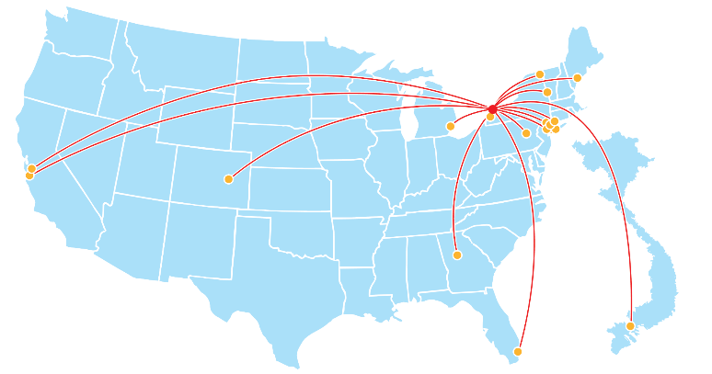
High Road Record 2021
Learning Apart Growing Together:
All High Roads Lead to Buffalo

Slide 2
Letter from the ILR Buffalo Co-Lab Director Cathy Creighton
The High Road Class of 2021 will always remain close to my heart. Leaving a 30-year career as a union side labor attorney was a difficult decision, but one reason for a late career change was to have the opportunity work with exceptional Cornell students in ILR’s flagship High Road Fellowship program. You all exceeded my expectations. I knew this was a special cohort from the moments of our first meeting when Lizzie described her home town from the view of a recalcitrant pet hound dog. From that day, until our last days’ discovery that Harry was a poet, you all worked as a cohesive and supportive group. Our goal in this program is for each of you to come to Buffalo and immerse yourselves in on the ground community change work. We want you to leave knowing that for the rest of your life you can be a change agent for the common good within any community you choose to work. We hope that we provided you with the training and skills to be able to be a force for change.
Hearing from over 50 (!) speakers in an eight-week period, we inspired you with stories of folks working every day fighting for equity in workers’ rights, climate change, police justice, massive racial and income inequality, and our very democracy. We hope that you gleaned how the arts is a powerful method of social change. You heard from High Road alums who have continued their High Road work as union representatives, journalists, lawyers for the dispossessed, and even as an NFL players’ association president. We heard from local elected officials who believe their role is to strive towards for a strong equitable society. It was notable that our speakers, who spend their lives toiling against oppression, autocracy and greed, are not cynical or depressed. Rather, they are creative and optimistic.
This is what I want for you; a life of rewarding work as joyful people fighting for the common good wherever you land. I want to you remember the close bonds of affection you have forged with each other. I want you to remember Buffalo as a place where you can always come home to, and where you will be embraced with thanks for the good work you have performed here on the High Road.
My warmest and deepest thanks, Cathy
Notes:
Option 2

Slide 3
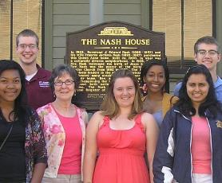
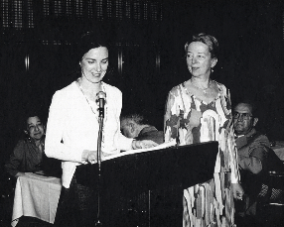
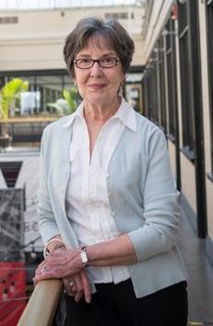
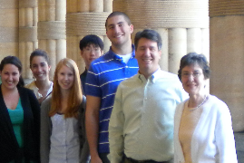
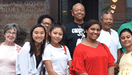
High Road Builder: Lou Jean Fleron
Lou Jean Fleron built the High Road Fellowship Program. She recognized the capability students have to contribute to the fight for public good. She realized that students are craving opportunities to roll up their sleeves, and get to work strengthening our communities. She grew the High Road Fellowship program from five ILR students in 2009 to 231 High Road alumni from six Cornell colleges, 29 states and seven countries. She built a program resilient enough to weather the shifts from a commuter program, to a residential program, to a virtual program. She is and will always be a dedicated mentor. She leads by example, showing what it looks like to dedicate your life to fighting the good fight. She has welcomed students into her home, her heart, her community since the first class of High Roaders in 2009. Her love for music shows students how art creates change. Her passion for making democracy work shows students what community representation looks like in action. Her dedication to her work and her family shows students how important it is to find balance. She makes sure each Fellow knows that they have a home here in Buffalo, that they made a difference in this community, and that they have the potential to do great things. From everyone who has benefited from this magnificently led program, thank you Lou Jean.
Notes:
Option 2

Slide 4
Letter from Lou Jean Fleron
To Be a High Road Builder: Appreciation and Reflection
In June 2009, five ILR undergraduates assembled in Buffalo for the first summer of High Road Fellowships. Not quite five months after the inauguration of Barack Obama, it was a time of high hopes; a signal that America had reached some higher ground. It was a wonderful summer, and the next year 14 Fellows came, then 18, after that 20 and 24. The 2021 crew brings the total to 231 High Roaders and Democracy Summer Fellows, coming from more than half the US states and 4 continents, working with almost 50 organizations, building a Better Buffalo. But numbers aren’t the story.
The story is what High Road Fellows have accomplished in this community and what they have gone on to accomplish in this world. The story is the people who make this all possible. To them I am unendingly grateful: colleagues and leaders at Cornell, ILR Buffalo colleagues, Partnership for the Public Good, Buffalo community leaders and activists who generously share their knowledge and their journeys with High Roaders. I am truly honored to be a High Road Builder.
The last two High Road Fellowship summers have been experienced virtually, giving more meaning to the challenge to “think globally, act locally.” High Roaders have been making it work simultaneously in Buffalo and in their own communities. In very difficult, yet promising times.
The pandemic-induced reflection of 2020 and 2021 has more clearly revealed systemic flaws in our democracy. As we’ve had our masks on, we are taking our blinders off! All around us we see gross inequalities, deep and painful racism and intolerance, frightening climate change and rampant misinformation.
Notes:
Option 2

Slide 5
…continued
To 2021 High Roaders: Just eight weeks ago I challenged you to be a radical, in the best and original sense of that word: to get to the root of matters. Get to the root of real community problems, real human and natural world problems, in order to collaborate on creative solutions, to construct more equitable and democratic institutions and policies. And that is exactly what you have done. High Road Fellowships are beyond “engaged learning.” They are experiences of activist learning—learning by making progressive change. As Angela Davis observed, “I think the importance of doing activist work is precisely because it allows you to give back and to consider yourself not as a single individual who may have achieved whatever, but to be a part of an ongoing historical movement.”
The summer of 2021 is proving to be an historical moment for Buffalo, New York, making national and international news for the upset election victory of community activist, India Walton. You have been a part of a momentous summer in Buffalo—a true testament to the robust civic infrastructure, the democratic and egalitarian organizations and practices that ILR and PPG have helped to build over the years.
As a founder of High Road Fellowships and as someone who has had the honor of witnessing the achievements of all 13 High Road Summers, I must say that you 2021 Fellows have especially understood the role of the arts to produce change. You have inspired us with your creative use of the arts as they expand our horizons, shake up our assumptions, and bring us together.
That brings us right back where I started—it’s the people! When Stephen McKinley Henderson expressed his “revolutionary optimism” through a humanistic lens, and when Dania Rajendra advised you to study history, humanities, and theory, they underscored: it’s what we know, how we understand, and what we do, as humankind on this planet, TOGETHER, that will shape the future—and it all starts right where we are, right now! On the High Road. . .with peace and love. LJ
Notes:
Option 2

Slide 6

Snapshot of Fellows
21 High Road Fellows
2 countries and 11 states
22 placements
1 Democracy Summer Fellow
4 Cornell colleges

Slide 7

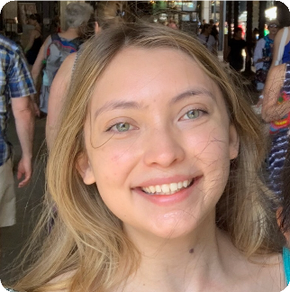
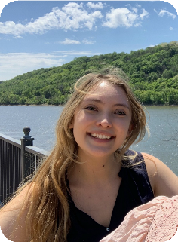

Alora Cisneroz
Los Gatos, CA
FAVORITE MEMORIES
Attending policy makers meetings and being amazed by the ways professional adults can be so civil and backhanded at the same time.
SUMMER TAKEAWAY
I have learned that there are so many people working behind-the-scenes to ensure that our communities function in ways that honor the high road.
Despite the army that it takes, it still seems like a fairly small world, where everybody knows one another. I think that I have learned that although non- profits can do great and wonderful things, they are often frustratingly limited by factors outside of their control (e.g. reacting to problems instead of preventing, not being able to lobby or endorse). Because of this, I don't know if I could see myself working long-term for a non-profit.
That's a new personal discovery for myself.
Analyzing the Climate and Community Leadership Protection Act (CLCPA) through the lens of environmental justice. I focused on the Climate Action Council's (CAC) transportation panel and created a policy memo brief that can be used by community members, county government, and activists.
Future Career:
I hope to work for the federal or state government in some sort of policy-making capacity, focusing on climate change.
MOST LIKELY TO SAVE THE PLANET
SHOUTOUT
I am grateful for our three wonderful fellowship organizers who have put together some of the most interesting materials and gathered so many impressive people. It's really incredible what they have pulled off.
PUSH Buffalo
Freshman, Arts & Sciences

Slide 8

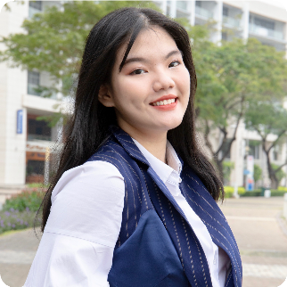

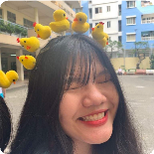
Anh Dao Truc Lam
Vietnam
FAVORITE MEMORIES
I think that my favorite memory during this summer was the first game night that I hosted. I have to admit that I am not a creative person when it comes to online group gaming. I did try to look up on the Internet but still couldn’t find any exciting games for groups. Fortunately, I was able to remember about Tien Len, which is a Vietnamese traditional game that can be played virtually.
The app was entirely in Vietnamese, so I helped the other fellows to navigate through the app. I must admit that our fellows are such fast learners, since they were able to beat over a Vietnamese that has been playing this game since the age of 5. Another memorable moment is when we were able to together construct a poem with the help of our wonderful guest speaker Aitina Cooke. I had not written any poems since high school, so this activity provided me with a space to once again be creative, to play with words, and to collaborate with other students.
SUMMER TAKEAWAY
High Road inspired me to apply my knowledge and skills to real life. I began my college journey. Most of my classes surrounded reading, writing, and discussing, which I didn't have any problems with! :) but I was feeling I lacked something greater. Then, I got into the fellowship program and finally had a chance to apply what I learned to the community in Buffalo. It is true that sometimes, the actual life is not similar to what I read in textbooks or learn in class discussions. However, it was more relatable and powerful. This once again reaffirms my decision to get a Ph.D. program. Before the fellowship, I had always wondered why we had to research while working directly with the community would better address the issue. However, after this summer, I realized that we research BECAUSE OF the community. Doing research is not just about getting your research published, but it’s about getting your community well-informed and making knowledge more accessible to the general public. Research enters people's lives in different ways, and I truly believe in the power of knowledge.
Arts Access Program
Future Career:
Since I just finished my freshman year at Cornell, I'm still figuring out what career path is the most suitable for me. it's a very tough decision. Right now, I am considering between management consulting and going to a Ph.D. program in Education.
SHOUTOUT
To be honest, I’m grateful for everything this summer. I’m grateful to be part of the High Road fellowship, wherein fellows come together to share ideas, listen to and discuss with speakers a variety of topics, including inequity, government, coalition building. (I also want to thank our fellows for helping me navigate my living conditions during the summer, especially with housing 😃). I’m also grateful for Wednesday skill-building programming because it teaches me the necessary skills for my career paths, especially if I decide to pursue a Ph.D. program. I also sincerely appreciate the knowledge and accommodation that Cathy, Kricky, and Micaela provide during the program, which has made my summer much better. And of course, I have to send a big thank you to Jen Swan, my supervisor, for guiding and teaching me a lot of new things throughout the summer. I was able to learn more about the process of appealing funding in the arts areas, about how to build partnerships, and so on. Lastly, I also want to thank my mentor, Samir Jain, for meeting me in person and telling me his experiences in the management consulting field.
MOST ENTHUSIASTIC
Arts Services Inc.
Freshman, ILR

Slide 9
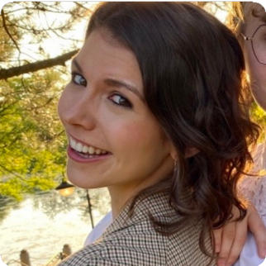
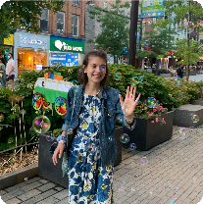

Callie McQuilkin
Ridgefield, CT
FAVORITE MEMORIES
My crazy 2 weeks in Buffalo, trying to interview 50 people in 10 days!
SUMMER TAKEAWAY
I've learned to love a new city, to have confidence in my ability to learn technical skills (let's go Python!). I've learned that there are a lot of activists in the world doing inspiring work. Meeting so many speakers passionate about in some way making an impact (whether that be through union organizing, police reform, or their many other interested) -- that energized me to take on my own challenges. Additionally, for my job -- conducting an oral history for the county -- I had to interview 60 people! The work made me realize I want a career where I'm doing the same, constantly greeting new faces and having good conversations.
SHOUTOUT
Cathy -- thank you for welcoming me to Buffalo and making a space where I felt at home. Micaela -- thank you for your energy, joy, and just on-the-whole great advice. You were a life mentor as much as a work one. Maria -- for empowering me to do this project. For welcoming me into her world at the Rath Building. For giving me more of an inside glimpse into policy work than I've ever had. For being one of the most inspiring mentors and sources of energy I've ever met Kara -- for always finding a time to fit me into Maria's schedule. Rusty -- for introducing me to Dr. Alyaqout, who believed in my abilities to scrape and analyze social media data, even when I had doubts. Dr. Alyaqout -- for the reasons mentioned above. Margot -- for showing me around the city of Buffalo Salima -- for all those incredible shoutouts, keeping our team looking its finest online. The High Roaders -- for pushing me to think deeply about the impacts we want to make on the world, for so actively engaging every Friday, for being a wonderful new group of friends to meet in person this fall.
Remembering the Lessons of Crisis: An Oral History of How Erie County Survived the Pandemic
INTERVIEW CHAMPION
Future Career: policymaker at the city level (preferably in NYC, but we'll see where life takes me!)
Erie County Deputy County Executive's Office
Junior, Arts & Sciences

Slide 10
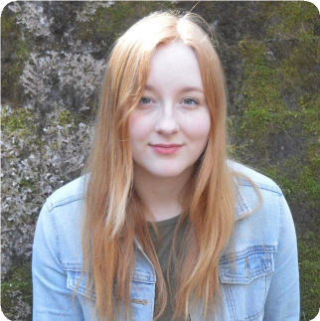
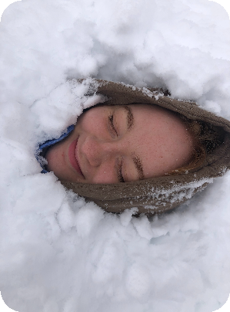

Elizabeth Taber
West Chazy, NY
FAVORITE MEMORIES
I always really liked the alumni talks and working with my supervisors was very rewarding.
SUMMER TAKEAWAY
High Road has reinforced my interest in labor and made me hopeful about my ability to find a role where I can influence public policy. High Road has absolutely made me much more of an optimist about both peoples willingness and ability to impact their communities for the better.
East Side Airport LRRT Extension Report
Future Career: considering law school and working as a public defender
MOST LIKELY TO GET ON THE RIGHT BUS
SHOUTOUT
You all have been so great and eager to help which I really appreciate. My supervisors Carl and Betsy are also some of the nicest and most enthusiastic people I have met.
Citizens for Regional Transit
Freshman, Arts & Sciences

Slide 11
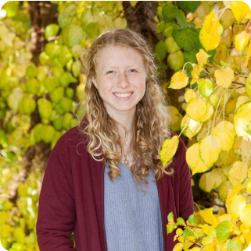
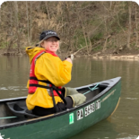

Hannah Drexler
Lewisburg, PA
FAVORITE MEMORIES
My highlight of the summer was meeting with Kate every day or couple of days to discuss the progress on my project and get her feedback. She is such a wealth of knowledge and it was awesome to learn and hear from her. More than a few times, my perspective on my project shifted, or I gained a new idea to look into, or we thought of a new person to speak to. These moments were awesome and brought my work to new levels. One favorite memory was meeting with Alex, Sarah, and Gabby from Senator Ryan's office. It was a new and more than meaningful experience to sit in a room with three women doing the type of work I'm aiming to do in the future. They were all encouraging and thoughtful both about the work I'm doing this summer and my future plans, which meant a lot to me.
MOST LIKELY TO ASK A DIFFICULT QUESTION
SUMMER TAKEAWAY
The most important thing I've learned through the High Road is the importance of engaging with and listening to the community I'm working for and actively incorporating their feedback into every decision and step I make with my projects. When someone is working in the realm of community-based development, they need to remember that the community comes before the development and that people matter most. I'd like to continue learning about how to build coalitions and lean into / engage with disagreement. I think handling difference is an important life skill and is one I'm constantly seeking to improve.
SHOUTOUT
The folks at the Western New York Law Center are committed 100% to the work they do and the clients they work to help. Kate must work from 8 in the morning to midnight every day, and yet she still stays grounded and remembers the mission she's working toward. I think I used to have a hard time negotiating the relationship between day-to- day work and the big picture and the Law Center was the perfect place for this understanding to grow. It is that relationship that allows the WNYLC to be so powerful: by working with clients daily, the staff and attorneys know the issues most affecting their community, and they are then able to fight for those issues on the policy stage. I have learned the importance of organizations and people that can be megaphones for their communities. I hope I've grown as a researcher and a communicator so I can do that work in my own communities now and in the future.
The Consequences for Homeowners and Communities of Erie County’s 18% Interest Rate on Delinquent Property Taxes
Future Career:
law school, policy work with a legal perspective or work in public interest law in the field of education or civil rights legislation.
The Western New York Law Center
Freshman, Arts & Sciences

Slide 12
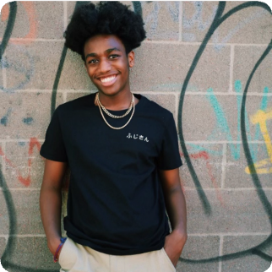
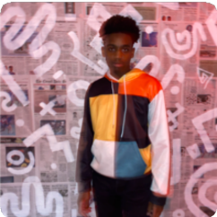

Harry Ducrepin
Suffern, NY
FAVORITE MEMORIES
The highlight of this experience has been being able to meet and connect with other fellows, especially since this past year has been so isolating.
SUMMER TAKEAWAY
I have learned about cooperative economics, community and coalition building, economic development, and about expanding my research skills. I would love to learn more especially about new generation economics, including worker cooperatives and other business models. The most inspiring lesson and my biggest takeaway is that learning is continuous. We never stop learning and expanding our ability to learn, but we restrict our willingness to learn. High Road has inspired me to actively seek new opportunities to
The first part of my project is documenting the rich history of Black worker cooperatives in Buffalo. The second part is researching policy and creating a report of policy suggestions to facilitate the creation and development of worker cooperatives.
POET LAUREATE
learn, because there's always something more out there.
SHOUTOUT
I'm grateful for everyone involved in making High Road so memorable. For those running it who have made everything smooth and enjoyable. For the fellows and all the conversations and laughs we shared. For my supervisors for this amazing chance to learn from them.
Future Career:
Public Interest Lawyer
Cooperation Buffalo
Freshman, ILR

Slide 13

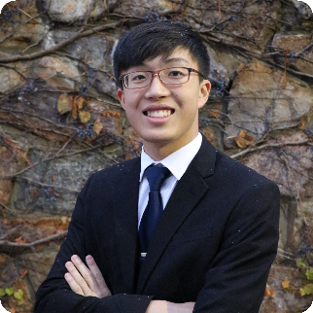
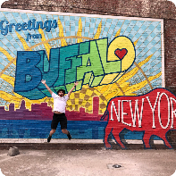

Jonathan Zheng
Elmhurst, NY
FAVORITE MEMORIES
Through the High Road, I have learned so much about the power and potential of community, art, and activism in changing the direction of progress. Whether it is from the Canalside fight against Bass Pro or the creation of the Freedom Wall, the work that people and organizations do can truly create a strong social fabric within a community. I would like to continue to learn about how nonprofits function and how careers in nonprofits progress.
SHOUTOUT
I am super, super grateful to Cathy, Kricky, Lou Jean, and Micaela for making this summer work as seamlessly as possible. I appreciate Kricky for being so understanding and helping me take care of my logistical issues for this summer - it was definitely integral to making sure I was able to do everything I wanted to do. Thank you Cathy, Kricky, Lou Jean, and Micaela for all your efforts and tireless enthusiasm; I know that that is something super difficult to do on hard days or even on a regular
A Report on Public Banking in the City of Buffalo. The research report will focus on the potential benefits and impacts a public bank can have on communities like Buffalo, particularly for low-to-moderate income (LMI) and minority communities. The project will help the Coalition in making the case for Buffalo to become a municipality that participates in public banking. It will also be used as a resource when meeting with state public officials and will help explain why Buffalo - and New York State as a whole - needs public banking.
Future Career:
Law Degree, Public Service, Government
basis.
HIGH ROAD MEME MASTER
SUMMER TAKEAWAY
The High Road Fellowship has only increased my resolve to do something good and socially beneficial for society with my professional career. The fellowship and working on Buffalo-specific issues have only reinforced my understanding of how deep inequality has pervaded into our society. Despite the constant doom-and-gloom of injustice and the apparent immobility of progress, the High Road has inspired me by seeing how organizations, activists, and, most importantly, communities, persist and continue to fight tooth-and-nail against systemic forces of oppression. Even when the odds are against them and victory seems slim, forces of good can prevail - as long as we collectively do not give up. The incredible work that all the alumni, speakers, and guests are doing demonstrates that idea very effectively.
Buffalo Niagara Community Reinvestment Coalition
Junior, ILR

Slide 14
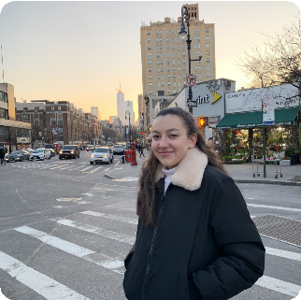
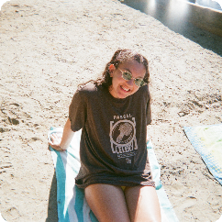

Julia Haberfield
New York, NY
FAVORITE MEMORIES
Calls with my supervisor Barry was always great. We worked really well together and I always enjoyed talking through ideas with him. I also loved talking to the other fellows in break out rooms, it was always a breath of fresh air during a work day.
SHOUTOUT
How invested everyone was in establishing the High Roads community in a virtual space! It's not an easy thing to do and it takes everyone motivating to remain connected.
MOST LIKELY TO ZOOM IN FROM SOMEWHERE COOL
Researching the most pressing housing needs in Buffalo and developing recommendations and action plans for how Habitat can better serve their community.
SUMMER TAKEAWAY
I feel like I've seen first hand so much hope and optimism surrounding
community based social justice movements and non-profit organizations. Learning how large and specialized this world is was great. I want to continue to meet the people doing this great work and working along side them, I really enjoyed it.
Having only spent one year at Cornell, and in a pandemic nonetheless, I only met a small portion of the student body. I remember ending the year a bit frustrated with some (definitely not all) of the people I met though in that I felt a lack of passion and care for things I care about.
High Road has flipped that around and introduced me to students who are extremely dedicated and interested in all things community engagement, research, prodding into new territory, etc.
Future Career:
Lawyer,
Teacher or
Journalist
Habitat for Humanity
Sophomore, ILR

Slide 15
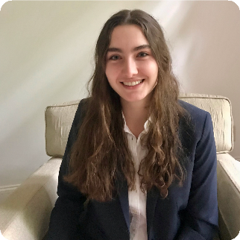
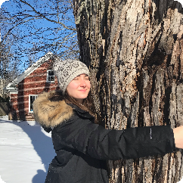

Katherine Esterl
Atlanta, GA
FAVORITE MEMORIES
The highlight of my summer was visiting Buffalo and seeing the historic sites I researched (and other High Roaders) in person. Also catching Mayor Byron Brown talking about speed cameras at a Merriweather Library event. And all the arts openers. And, of course, Anh's Vietnamese- style game night.
SHOUTOUT
I'm grateful for Kricky, Cathy, Lou Jean, and Micaela and all of the time and energy they dedicate to creating this summer. They have other life/work responsibilities, too, and yet they are always immediately accessible by text or email or call, and always able to guide, support, and encourage students (they also have a wealth of knowledge and experience). And I'm grateful for all the other High Roaders -- we made it through in a really weird zoom world.
SUMMER TAKEAWAY
Community engagement is everything. And that doesn't mean making decisions for others. It means listening to the communities most affected by policies, building coalitions, and supporting advocacy toward a common goal. I want to continue learning how to listen and how to advocate, how to keep an open mind and how to speak with conviction.
The High Road taught me to think more critically about politics, policy, capitalism, power structures, racism, and the possibilities for progressive change. It made me think more critically about my role in my community and how our lives are interconnected. I better understand the need for collective power, and I'm inspired to be a part of it.
East Side History Initiative
Future Career:
My goal is attend law school. I'm interested in constitutional law, civil rights, and immigration. PBN has also taught me there is room for attorneys in the preservation and urban planning world -- which I'm now seriously considering!
JOURNAL
GENIUS
Preservation Buffalo Niagara
Freshman, Arts & Sciences

Slide 16
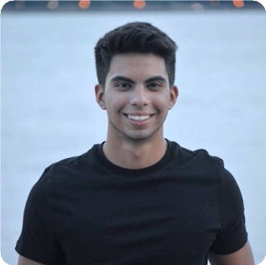
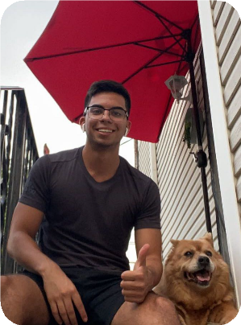

Kevin Diaz
Ridgefield, NJ
FAVORITE MEMORIES
Being able to live in Buffalo and get to know the beautiful city! Seeing some of my fellow high roaders, attending a rally, and eating buffalo wings
SUMMER TAKEAWAY
I learned the importance of mobilizing and organizing a union. I’ve also learned about the healthcare inequities among workers in medical institutions through both research and collective bargaining. I would want to continue to learn more about how to conduct research and what other powers grassroots organizations have. The High Road has inspired me in a positive way by allowing me to see for myself the impact that grassroots organizations can have.
Healthcare Inequities from a Workers Perspective
MOST LIKELY TO
STRIKE
Future Career: Lawyer, Foreign Service, Consulting
SHOUTOUT
I am grateful for the CWA for giving me the opportunity to be able to go to Buffalo and work with them in person! Shoutout Erin for driving me to and from work
Communications Workers of America
Freshman, ILR

Slide 17
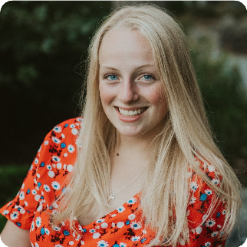
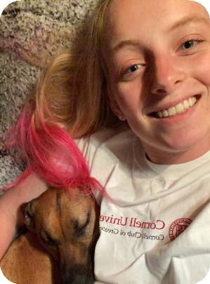

Margot Treadwell
Elma, NY
FAVORITE MEMORIES
The highlight of my summer was working with the Farm Market on Tuesdays, come rain or shine. One day we almost got struck by lightning.
SUMMER TAKEAWAY
I learned the importance of considering a whole community. I never really understood the power of coalition building until I can to the High Road. I want to continue to learn how to connect with community members, ask them what they need, and convince them to join the fight. I gained a lot more perspective on the foundations of community, and how we continue to pull everyone forward together. I became a lot optimistic about the power of targeted changes and small, passionate groups.
Mapping SNAP sites with Produce to help the Farm Market
MOST LIKELY TO BE BUFFALO’S MAYOR
SHOUTOUT
I was most grateful for Micaela, Kricky and Cathy. Their kindness, wisdom, flexibility, and guidance was invaluable, and will be something I carry with me for the rest of my Cornell experience.
Future Career: Foreign Service Officer
FeedMore WNY
Freshman, ILR

Slide 18
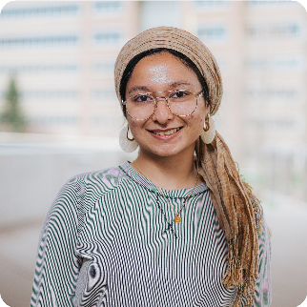
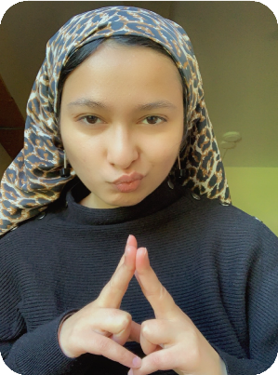

Nabiha Qureshi
Melville, NY
FAVORITE MEMORIES
I loved attending meetings with all the participants involved. Interacting with participants in trainings and meetings narrowed the gap between my efforts and the impact of my efforts. This is a valuable experience for anyone who feels a disconnect between their labor and the results of their labor.
SUMMER TAKEAWAY
I’d like to learn about how new skills can be developed to advance social justice in communities.
King Urban Life Community project- housing assistance in Buffalo neighborhoods
Future Career:
Work in international development
MOST LIKELY TO QUIETLY TAKE OVER THE WORLD
SHOUTOUT
My Americorp vista partner Jenna.
Community Action Organization

Slide 19
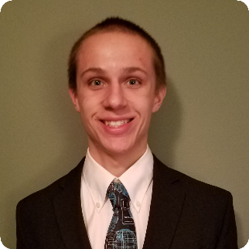
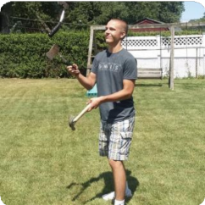

Paul Havern
Warren, MI
FAVORITE MEMORIES
I loved attending meetings with all the participants involved. Interacting with participants in trainings and meetings narrowed the gap between my efforts and the impact of my efforts. This is a valuable experience for anyone who feels a disconnect between their labor and the results of their labor.
SUMMER TAKEAWAY
I learned so much about community development and "taking the High Road," as we like to say. Community input must come first whenever considering economic development. I would like to continue learning about ways to use local politics to enact lasting change. I feel that too often people feel the need for national and state-wide movements when local answers could be the solution. I want to explore this more. The High Road has inspired me to appreciate what I have. I have taken for granted the knowledge of my community members on so many topics, but the High Road has shown me how much value exists in any person's neighborhood. I cannot wait to take this message with me in my professional and academic career.
SHOUTOUT
Updating Diversity, Equity, and Inclusion Initiatives for employers in the Buffalo area (I also attended various meetings in the organization to enrich my experience)
Future Career: Public Defender
MOST NICHE INTERESTS
I am most grateful for Kricky, Cathy, and Micaela for organizing this fellowship. I cannot imagine the work that went into transferring this program to an entirely virtual format. The enthusiasm and excitement of you all is inimitable. The passion of you all is so incredible that I feel I can go miles and miles with just a fraction of it! I thank you from the bottom of my heart for making this fellowship as fantastic as it was.
Thank you. Thank you! Thank you!
Center for Employment Opportunities
Sophomore, ILR

Slide 20
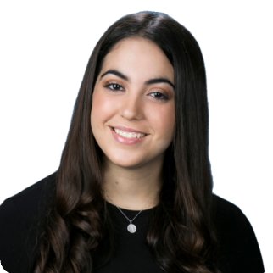
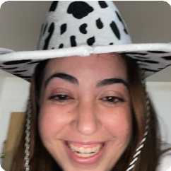

Raquel Zohar
Adventura, FL
FAVORITE MEMORIES
My sister got married at the end of June! It was very emotional, a lot of fun, and a milestone that I am not likely to forget soon! :)
My High Road highlight and favorite memories have been interviewing Buffalonians for my project -- they're all so amazing, know their communities so well, and share the most meaningful tidbits of advice for the future.
SHOUTOUT
I am grateful for our very lighthearted and fun cohort, for Micaela's patience, for my supervisor Mara who is so kind and flexible and willing to help, for Cathy's sense of humor, for Kricky's leadership, for Lou Jean's wisdom, for my family's support in everything I do, and for google calendar who kept it all together for me this summer.
Hate Crime Incidence and Community Responses to Hate in Greater Buffalo
Future Career: Career in Disability, Human Rights, and Labor & Employment Law
SUMMER TAKEAWAY
I have learned the importance of reflection and connection. It is one thing to say that you care about High Road values but it is another to actively work to better communities and shared society for all. To uplift the High Road is, indeed, to act and it is to act in the best interests of people, a goal which may only be attained through personal connection and understanding. It is imperative that we talk to one another and learn from one another so that we may develop shared understandings and make change for the better. It is also imperative that we reflect on our own actions. What we have done in the past may not have been best to achieve betterment and may have even been a slew of mistakes. We must change our behavior accordingly if need be and reflection is the best way of identifying need for changes.
MOST LIKELY TO BECOME A STAND-UP COMEDIAN
Buffalo Jewish Community Relations Council
Sophomore, ILR

Slide 21
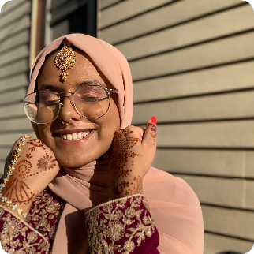
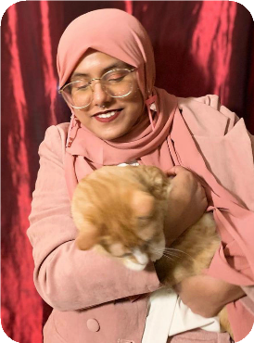

Sabiha Obaid
Buffalo, NY
FAVORITE MEMORIES
My highlight of the summer was whenever I hung out with the other fellows. The dinner at Cathy's place and brunch was really fun! I loved seeing everyone and the food was great.
SUMMER TAKEAWAY
Through High Road, I learned so much more about Buffalo and the different socioeconomic issues here. I would love to learn more about different actionable steps we can take to help our communities. High Road has inspired me to step out of my comfort zone and interact with the people around me. Everyone has their own individual stories and we can learn from each other. It also made me fall in love with Buffalo. Ever since I moved here, I always felt a bit disconnected but with this fellowship, I made new friends and learned so much about the city.
SHOUTOUT
I am incredibly grateful for Micaela, Kricky, and Cathy. There has been a lot happening in my personal life and throughout it, all three were so supportive and understanding. Experiencing their compassion made this fellowship such a great experience. I am forever grateful to them.
Kinship Program
Future Career:
As of now, I am still uncertain of what exact field I want to join. However, I know I want to have a community centered career where I am actively working with people.
MOST LIKELY TO
DISMANTLE
CAPITALISM
Center for Elder Law and Justice
Sophomore, ILR

Slide 22
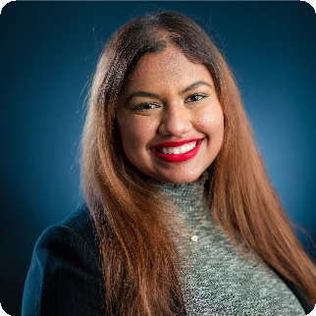
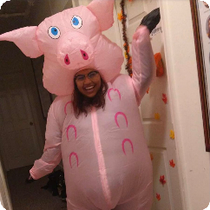

Salima Ali
Ozone Park, NY
FAVORITE MEMORIES
Some of my favorite memories have been in breakout rooms where I was able to learn more about the other fellows and their personal lives. It was a great opportunity to learn more about them beyond their zoom screen.
Specifically, with The Foundry, on my first day, my amazing supervisor Deb took me on a virtual tour (through google meets) of their office and it was really engaging and I enjoyed seeing The Foundry's impressive office space.
SHOUTOUT
I would like to thank Cathy, Micaela and Kricky for all the work they have put into this program. People like the three of them are the ones who inspire me to be a better person. They all have such real perspectives of the world and still remain positive. I would like to thank the fellows for making this such a fun experience. Also, shoutout to Lucy!
Lastly, a special shoutout goes to Deb, Adam and Amina at The Foundry for their endless support and everything I've learned from them.
Workplace Development For Marginalized Communities: Social Enterprise Creation, Funding Opportunities and Material Research
SUMMER TAKEAWAY
From this program, I learned that one of the greatest keys to creating change is knowing the community that you're creating change for. If it were not for all the high road programming and the pre course, all of the fellows would be placed in a community with no understanding of what they are like and attempt to create change. The High Road programming helped prevent us from developing savior complexes when trying to create impact. I will forever remember to take account of the communities my actions are impacting before attempting to create change.
IG BADDIE
Future Career: Lawyer
The Foundry
Sophomore, ILR

Slide 23
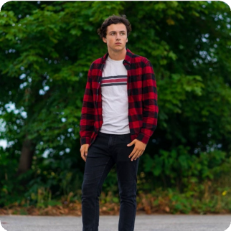
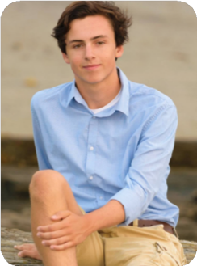

Sam Curtis
Scarborough, ME
FAVORITE MEMORIES
The highlight of my time in the High Road program was being able to hear from the variety of insightful speakers attending the Friday program sessions each week.
SUMMER TAKEAWAY
Throughout the High Road, I have learned about the various ways social and political institutions perpetuate inequality and the ways we can take action to reduce these barriers. Out of the topics we have covered, I would like to learn more about the inequalities involved in the criminal justice system and the movement in shifting towards community-led policing. The High Road has inspired me through showing how accessible it is to take action to address social inequalities. I had frequently heard the concept of advocating for social change referenced but had little idea of how I could take meaningful action on my own terms.
BCAT Program Expansion Proposal
Future Career:
I hope to attend law school and ultimately work for the government to shape policy related to economic regulation and infrastructure.
MOST
MUSICAL
SHOUTOUT
I am grateful for Kricky, Cathy, and Micaela for making the program possible, as well as my supervisors Matt and Brittany for guiding me through the program.
Buffalo Center For Arts and Technology
Sophomore, ILR

Slide 24
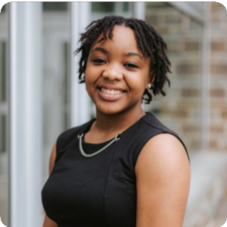
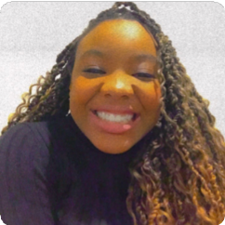
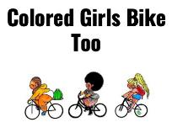
Samantha Ivey
Mechanicville, NY
FAVORITE MEMORIES
My highlight would be collaborating with everyone to create a poem with Aitina Fareed Cooke during our Friday Programming.
SHOUTOUT
I am firstly so grateful for fellow High Roaders in going through this experience with me and doing the work to create social change. I am so happy to see a group of like minded people who want to create a difference in the world. I'm also so grateful to Cathy, Kricky, and Micaela. Without their work and dedication to create programing and ensure that our experiences were going well, this summer would not have been possible! I am so continually grateful for my supervisor, Jalonda Hill. She has shown me what it means to be a radical changemaker for social good and I am so happy to have been placed with Colored Girls Bike Too.
Create social media campaigns, develop programs and events and collaborate in creating organizational structure
BEST
STORYTELLER
Future Career: Working with the ILO to establish fair labor rights for all people.
SUMMER TAKEAWAY
This summer I have learned so much more about how to create a positive change in the world. Before my High Road experience, I feel that I had a great awareness of world problems but now I feel that I have a better understanding of world solutions. I hope to continue to grow in my understanding of both world problems and how to create more equitable world solutions.
Colored Girls Bike Too
Freshman, ILR

Slide 25
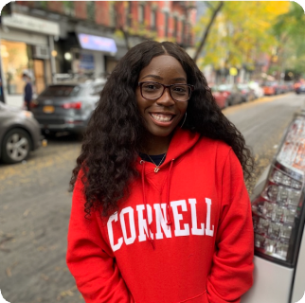
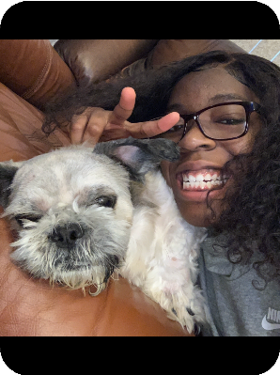

Uwaila Odiase
The Bronx, NY
SUMMER TAKEAWAY
Through High Road, I learned a lot about the different ways in which I can actively advocate right now. Prior to the fellowship, I felt constricted in many ways due to my age; I saw social media as my only platform to spread information. However, I now realize that my interactions with people are far more important than I give credit for. Something like coalition building is not something that I have to wait 5 years before starting; I can start it now. I remember the woman who spoke to us about how she started a gardening program during the first few months COVID-19 to combat food insecurity in Buffalo. I was just so amazed that she was able to start something so impactful without numerous external resources. That is just one of the many highlights from my experience that has prompted me to really start to think about solving issues in my community differently instead of looking at it as just some impossible issue for the next politician to 'solve'.
interviewing Landlords in the Buffalo region and securing housing for formerly incarcerated individuals.
REFLECTION CONNECTION QUEEN
Future Career: Practicing Attorney
Peaceprints of WNY
Freshman, Arts & Sciences

Slide 26
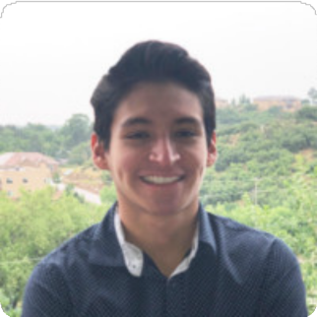
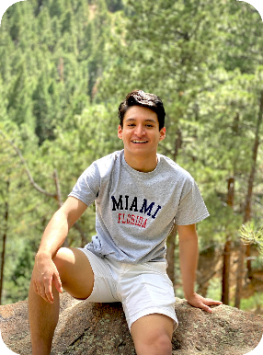

Victor Rosas
Colorado Springs, CO
FAVORITE MEMORIES
Easily the poetry session with Aitina. Also enjoyed talking to Uwaila during my game night. (She’s the only one who came, and it was nice to get to know her.)
SUMMER TAKEAWAY
I learned about the importance of
community organizations in pushing for legislation. I always knew they played an important role but never considered how nearly all pieces of legislation starts first with them before becoming law. I'd like to continue to learn about how the community creates laws, and I hope to do that kind of work after I graduate college.The High Road made community-led change three- dimensional for me. I realize now that I only truly understood the High Road as it pertained to theory—what scholars or journalists had to say about change from the community. But the High Road program offered me a practical, engaged learning experience where I can ask questions to the people making change in Buffalo, as well as work
Budget Advocacy
Future Career:
Not too sure. The plan right now is to do some kind of civil rights law and then run for office.
alongside some of the community changemakers.
SHOUTOUT
BEST ADVOCATE
Very thankful for Micaela. She was always willing to lend a hand with my project. I appreciate her.
Partnership for the Public Good
Junior, ILR

Slide 27
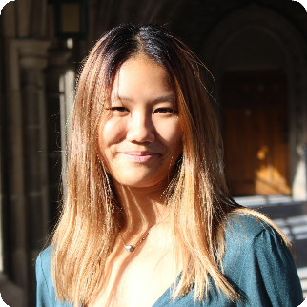
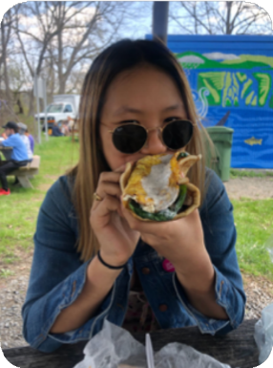

Wendy Wang
Whitestone, NY
FAVORITE MEMORIES
For me, I really enjoyed interviewing local community gardeners, and hearing about how their gardens positively affected their neighborhoods, and also the alumni zooms.
SUMMER TAKEAWAY
I've learned a lot about city government, and local public policy, as well as coalition building and the history of labor moments, all of which are things I would love to continue to learn about.
SHOUTOUT
The chance to just learn so much, in such a short amount of time.
I helped research community garden policy in the Buffalo-Niagara Falls through conducting interviews with local gardeners, as well as assisting future healthy Corner Store initiatives and community gardens in the Niagara Falls area through mapping food access spaces and empty lots in the area.
Future Career:
public service in either public policy or legislative work.
MOST LIKELY TO WORK IN THE SENATE
Field and Fork Network
Freshman, Arts & Sciences

Slide 28
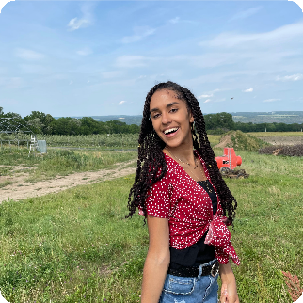


Yasmin Ballew
Manteca, CA
FAVORITE MEMORIES
Meeting some of the other fellows at CTB and comparing our placement projects.
SUMMER TAKEAWAY
I have learned about what community organizing and collation building looks like at the grassroots level. High Roads has reminded me that even when I may feel overwhelmed or exhausted in my struggle for equity and racial justice, I am never alone.
Created case studies and performed Comparative Analysis on Foster Care and Housing Departments.
BEST CONVERSATIONALIST
Future Career:
Public Interest Attorney
SHOUTOUT
I am especially grateful to Kricky and Micheala. They stepped up to provide me with the support and guidance I needed when I was feeling confused and overwhelmed in my placement.
Buffalo Urban League
Sophomore, ILR

Slide 29

Week in the Life
Students may have participated in a virtual Fellowship this year. But that does not mean that they didn’t engage as a cohort. We learned from lessons of last year’s virtual Fellowship and crafted weekly programming which allowed students to engage, reflect, learn, and grow together.

Slide 30



Each Tuesday, High Road alumni are invited to meet with the full cohort of High Road Fellows. Alumni Meet and Greets provide students with the opportunities to hear about what it is like to work in a variety of fields from law to unions to journalism and more. Alumni also provided guidance on how to integrate the High Road Fellowship experience into the remainder of their Cornell experience.
Tuesday Alumni Meet and Greet
High Road Alumni Meet and Greet Speakers
Derya Akbaba, ILR 2013, University of Utah, PhD Student
Grace Bogdanove, ILR 2019, 1199 SEIU
Maame Britwum, ILR 2020, Facebook
Sherell Farmer, ILR 2022, Co-Founder of Cornell Students 4 Black Lives
David Huang, ILR 2014, Southern Migrant Legal Services
Daniel James II, ILR 2022, President of. ILR Student Government Association
Hannah Lorenc, ILR 2019, 1199 SEIU
J.C. Tretter, ILR 2013, NFL Players Association
John Yoon, A&S 2020, The New York Times
Notes:
Option 2

Slide 31
Wednesday Skill Shares
Thursday Game Nights
High Road Fellows met on Wednesdays to learn a new skill. Fellows requested a variety of skills trainings in topics they wanted to explore more. Many skill shares students were able to immediately apply to enhance their Fellowship projects. Skill shares included Breaking Down Policy Analysis; Organizing 101; Mapping Using ArcGIS Online; How to Use Canva for Savvy Social Media Strategies; and, Unpacking Qualitative Data Collection.
One of the biggest challenges of a virtual High Road Fellowship is ensuring that Fellows have the chance to get to know one another. One way that we combatted this isolation was by instituting Fellow Game Nights. Each Thursday, a Fellow would volunteer to host game night. Game nights provided opportunity for Fellows to get to know one another in a casual setting without faculty or staff present. We know that a weekly game night did not make up for the in-person adventures lost, but they did allow Fellows to bond as a cohort.
Notes:
Option 2

Slide 32
Thursday Journals
Journal Prompts
What community need, work challenge, or public issue have you given the most thought to this summer?
What is the most effective action that can be taken right now to combat
systemic racial inequity in the United States?
Please share a poem, piece of art, music, or other form of creative expression that is a culture changer.
How does the concept of environmental racism help us to redefine environmentalism to apply to urban areas and marginalized communities?
Why is equity important? How does the fight for equity in your home community compare to what you’ve learned about the fight for equity in Buffalo?
What are your hopes for a better democracy in our country?
What kind of impact do you hope to make this summer?
Throughout human history, real social progress is always the result of a people’s movement. What movement are you in or helping to create?
A crucial part of any engaged learning program is reflection. As in prior Fellowship years, each Thursday Fellows submitted a journal entry reflecting on the theme of the week. Fellows drew from personal experiences, work at their placement, family memories and more to integrate what they learned. Students were encouraged to submit poems, drawings, collages and music to independently find their own forms of creative release. Journals became a forum for students to interact. Each Thursday afternoon, students read each others’ journals and provided comments, encouragement, and validation. In a democratic process, each Friday students voted for which journals they would like to see become public facing blogs.
Notes:
Option 2

Slide 33

“We need allyship and coalition. If we can build alliances and coalition, we may shift our frames of mind to serve the public good and combat racial inequity through allyship. We must have those more difficult conversations and aid persistence and partake in ways to amplify first-person voices. Only then can we address our flaws, reflect, learn from our mistakes, and collectively build towards a more equitable future with less disingenuity, hate, and oppression. To illustrate collective efforts in building towards a brighter, more racially equitable future, I combined elements of Judaism and Civil Rights. Pictured below is our world resting on Shimon HaTzaddik’s conceived three pillars that serve to revitalize our world. The first on the right reads Avodah, or service. The middle pillar reads Gemilut Hasadim, or acts of kindness, and the third pillar on the left reads Torah. From our world emerges a crowd of faceless marchers, people who serve as a reminder that regardless of our differences, we are ultimately all the same, all linked, all interconnected, and all interdependent. We are all ultimately one. The crowd is led by Dr. Martin Luther King Jr., Ralph Abernathy, Rabbi Maurice Eisendrath, and Rabbi Abraham Joshua Heschel (I have not been able to identify the other two men in the image), in a recreation of an illustrious image from a march in Montgomery, Alabama. This image represents education and engagement, for it is a depiction of growing empathy, of cross-community coalition building, and of fighting for racial equity. May we all partake in further education and engagement to formulate a more equal and more prosperous future.”
Allyship and Coalition
To the left is an excerpt from one of Raquel Zohar’s journal entries.

Slide 34



Friday Group Programming
Each Friday, Fellows participated in virtual day-long programming as a cohort. Fridays had a theme which narrowed in on different aspects of the High Road. The virtual nature of the Fellowship allowed for the opportunity to invite guests from across the country to unpack the day’s theme with the Fellows. Guests included actor Stephen McKinley Henderson, Congressman Brian Higgins, and numerous other amazing individuals. Friday guests allowed students to ask real questions about the difficult work of navigating the High Road.
Friday Themes
The Intersection of Public Policy and Climate Change: Whose Job Is It?
Workers Rise Up-What Will Light the Fire?
The Arts and Cultural Change
Community Safety and Health
The Long Shadow of Inequality
Democracy Imperiled: The Rigged Economy and Money in Politics
Notes:
Option 2

Slide 35



Arts Openers
The High Road Fellowship is rooted in a commitment to the arts with a strong belief that the arts is one of the premier forms of advancing social change. Therefore, each Friday we start of group programming with an arts opener. Fellows volunteer to lead an arts opener during which they share a piece of art or group of art that they feel moves forward a High Road value. This year, Fellows went above and beyond in crafting insightful arts openers which led to reflective discussions throughout the Fellowship program.
Notes:
Option 2

Slide 36
Thank You To All Our Stellar Group Programming Guests
Karima Amin, Prisoners are People Too
Ellen Banks, Sierra Club
Chairwoman April Baskin, Erie County Legislature
Maurice Brown, 1199 SEIU
Alma Carillo, Buffalo Arts Studio
Maya Cutforth, M&T
Meghan Maloney De Zaldivar, New York Immigration Coalition
Orlando Dickson, PPG
Aitina Fareed-Cooke, Get Fokus’d Productions
Kathryn Franco, Buffalo Niagara Community Reinvestment Coalition
Rob Galbraith, Public Accountability Initiative
Rahwa Ghirmatzion, PUSH Buffalo
Kim Gibson, 1199 SEIU
Miles Gresham, PPG
Jillian Hanesworth, Open Buffalo
Jim Heaney, Investigative Post
Stephen McKinley Henderson, actor
Michael Heubusch, Cooperation Buffalo
Congressman Brian Higgins, United States House of Representatives
Jalonda Hill, Colored Girls Bike Too
Glenn Jackson, M&T
Jonathan Johnsen, Creighton Johnsen & Giroux
Ba Zan Lin, The Community Foundation
Tommy McClam, Boys and Young Men of Color Initiative
Matt Nagowski, M&T
Rebecca Newberry, BlueGreen Alliance
Andrea Ó Súilleabháin, PPG
Mark Pearce, Buffalo Artist
Diane Picard, Massachusetts Avenue Project
Dania Rajendra, Athena Coalition
Paul Russell, musician
Senator Sean M. Ryan, 60th Senate District
Zainab Saleh, PPG
Andy Smith, M&T
Brian Smith, Citizens Campaign for the Environment
Maria Ta, Ujima Theatre
Maiko Tanaka, Squeaky Wheel
Win Min Thant, Agent of Change
Erika Tozser, M&T
Edreys Wajed, Buffalo Artist
Dave Wasiura, United Steelworkers
Gail Wells, elder and mentor
Alex Wright, African Heritage Food Coop
Notes:
Option 2

Slide 37



This summer, Fellows had the opportunity to be paired with High Road alumni mentors. Fellows who opted into the mentorship pairings were matched with alumni based on career interests, shared identities and positionalities, and geographic location. Mentors were able to provide one-on-one insight into potential career pathways and how to live out High Road values post graduation.
One-On-One Alumni Mentors
High Road Mentors
Jeffrey Joseph, ILR 2015
Arielle Kopelle, ILR 2015
Samir Jain, ILR 2019
Kwan Park, ILR 2012
Marc Masson, ILR 2017
Sam Bordia, ILR 2011
Cole Norgaarden, AAP 2017
Erin Killian, ILR 2017
Michael Dolce, ILR 2011
Kyle Friend, ILR 2018
Deanna Hall, ILR 2015
Chris Bain, ILR 2015
Courtney Sokol, ILR 2015
Victoria Neenan, AAP 2017
Allison Considine, ILR 2017
John Yoon, A&S 2020
Dan Powers, ILR 2014
Notes:
Option 2

Slide 38
High Road Showcase
Students dug deep and produced a wonderful High Road Showcase. They shared poems, videos, collages, paintings, data visualizations, and more. Many of the showcase presentations revolved around the power of art to create change across distance, perhaps inspired by our year of Zoom classes and meetings. The theme of the showcase “Learning Apart Growing Together: All High Roads Lead to Buffalo” was chosen by consensus among the students who volunteered to serve on the Graduation Committee. The Graduation committee also chose other aspects of the High Road Showcase including superlatives awarded to each Fellow recognizing a strength they showed over the summer, as well as the High Road Musical Guest Paul Russell.

Slide 39






High Road Showcase Student Work
Management
Unions
Demolition Permits since 2007 are mostly East of Main Street

Slide 40

Regrowth
Future
The Sky, the vine, the mushrooms, the tree, the concept of weeds. Sustainable Growth. Open sky.
The painting to the left titled “Regrowth” (acrylic on paper) was created by Lizzie Taber for the High Road Showcase. The engine represents Buffalo’s position as a rust belt city and Lizzie’s placement with Citizens for Regional Transit. The sky represents the growth and potential Buffalo has. The 22 Native NY plants associated with spring and early summer represent the 22 High Road Fellows and healthy, sustainable growth.
History
The engine, Industrialism, Rust, Groundwork as both a challenge and opportunity.

Slide 41
Buffalo and the American Dream
Dear Mẹ,
Why is the American Dream so far away?
It’s not like what uncle Hai describes,
My America,
Is not San Jose filled with sunshine,
Is not open highways with stylish sports cars,
Is not six-figured jobs right after graduation,
Nor a democracy with justice
and
Freedom like what others say, Mẹ ạ!
My America,
In the city of Buffalo with freezing winter,
With neighborhoods segregated by race and ethnicity,
With 4 people living in one single junk room
With people overwhelming themselves
with 2-3 jobs just to survive.
Wis the American Dream Mẹ?
Dear Mẹ,
Maybe-
Capitalism failed us!
The American Dream is an unreal dream,
Is an endless exile,
The more we try to reach, the farther it is.
But…
I have trust in America Mẹ!
My America-
Is the city of Buffalo with freezing winter,
With hearts warmed by kind empathy,
With brave humans always ready to fight for justice,
And with young people heading
towards their communities,
My America-
Is where I can see passports with different colors,
Is where I understand my identity more
than ever before,
Is where I stand up for what I believe in life,
And is also where my voice gets heard by others.
Dear Mẹ,
America does not teach me to become a billionaire
But…
It teaches me to have trust in humans,
It teaches me to be confident in my own voice,
It teaches me to thrive for my community.
Yes Mẹ, America does not teach me to be an American.
But…
It teaches me to become a better Vietnamese.
The Poem “Buffalo and the American Dream” was written by Ahn Dao Truc Lam from Ho Chi Minh, Vietnam in preparation for the High Road Showcase.. Mẹ, which means Mom in English, was retained in Vietnamese to honor Anh’s mother.

Slide 42
The Things They Carried on the High Road
Each summer, one of the highlights of the High Road Fellowship program is a workshop with Aitina Fareed-Cooke. Aitina crafts a poem with the fellows, exhibiting how words and lyricism and poetry can be used to communicate High Road values and shape a movement. Please find below the poem written collectively by the 2021 cohort of High Road Fellows.
They carried a battered journal,
Taking in 99 well-guarded secrets.
They carried nostalgia in their bones and hope hung in the air, Take care.
They carried stories on their tongues and progress in their view,
Stay true.
They carried friendship, freedom, focus.
They carried pride, persistence, purpose.
This all they carried on the High Road,
And in the end it was all worth it.
They carried half used hand sanitizer
The killer of 99.9% of germs.
They carried AirPods Pro,
The killer of 99.9% of distractions.
They carried crumpled passports with tattered stamps,
Capturing 99.9% of countries.
They carried well-loved, worn out photographs,
Capturing 99.9% of memories.
They carried a scratched lighter,
Taking 99 tries to start a flickering fire.

Slide 43


High Road Showcase Speakers
India Walton
Paul Russell
India Walton
Buffalo Community Member and former
Founding Executive Director of the Fruit Belt
Community Land Trust
Born and raised on Buffalo’s East Side as one of six children, India became a full-time working mother at the age of just 14. She earned her GED while pregnant with twins who were born prematurely, an experience that inspired her to become a nurse in the same NICU where her boys’ lives were saved. As a healthcare worker, India became a representative in the 1199 SEIU union, standing up for both workers and patients from picket lines in Buffalo to the steps of the U.S. Supreme Court, where she was invited to speak at a national women’s rights rally in 2014.
Continuing to serve as a nurse in Buffalo Public Schools, India witnessed the health disparities among our most vulnerable citizens and became determined to change the systems that cause these injustices. India’s commitment to systemic change called her to become a community organizer for Open Buffalo, establishing herself as a thought leader on a wide range of issues including criminal justice reform and fair housing. Her work on the latter led her to be named the founding executive director of the Fruit Belt Community Land Trust, for which she worked with longtime residents to develop permanently affordable housing.
In 2021, India became the Buffalo mayoral Democratic primary winner, but was ultimately defeated by a write-in campaign launched by incumbent mayor Byron Brown.
Singer and Musician
Paul graduated from the ILR School in 2019 after completing the High Road Fellowship in 2016 where he was placed at Partnership for the Public Good. Since graduating, Paul Russell has continued the tradition of reflection through writing music which he started on the High Road. Russell’s songs have gained popularity nationwide, but “Black and Blue in Dallas” which was written for Russell’s High Road Graduation Showcase will always be our favorite.
Notes:
Option 2

Slide 44



Faculty and Staff
Cathy Creighton
ILR Buffalo
Co-Lab Director
Kricky Ksiazek
Collaboration & Research Specialist; High Road Fellowship Co-Coordinator
Micaela F. Lipman
High Road
Fellowship
Co-Coordinator
Catherine Creighton is the Director of Cornell University ILR Buffalo Co-Lab. She is a graduate of Cornell University’s ILR School ‘87, and later attended Boston University School of Law. For thirty years, she worked as an attorney in the field of labor relations, first as a field attorney for the NLRB, and then as a union-side labor attorney where she co-founded the firm Creighton, Pearce, Johnsen & Giroux. She represented private and public sector unions in NLRB and PERB matters, arbitration, contract negotiations, and general litigation. Cathy also represented individual workers in discrimination matters, Federal and State litigation, employment contracts, severance agreements, and wage theft cases.
Early in her career, she served as an adjunct instructor in the Labor Studies program of the Cornell University ILR Extension. She has lectured for Continuing Legal Education programs for the AFL-CIO, Cornell University, and the National Labor Relations Board and has written for legal publications. She has also conducted numerous labor union officer and stewards’ training workshops.
Kricky Ksiazek is the High Road Fellowship Coordinator and Collaboration and Research Specialist working on Buffalo Commons, a joint collaboration between Cornell ILR Buffalo Co-Lab and Partnership for the Public Good. The goal of Buffalo Commons is to facilitate the network of researchers and partners on Buffalo-Niagara focused research and to disseminate this information in the digital library. She earned an MPA in Education Policy & American Indian Studies from Cornell University, holds a Master of Arts degree in Elementary Education from the University of New Mexico and a BA in Economics and Peace Studies from the University of Notre Dame. A native western New Yorker, she is Seneca, hawk clan, and Polish. She worked with the NACA Inspired Schools Network on developing an Indigenous Education Knowledge Management system, supporting and developing community-designed and led schools for Native students. She served as the Director of Strategic Initiatives and Partnerships for Teach For America's Native Alliance Initiative, building a strong community of Native leaders focused on culturally responsive education and was a middle school math teacher in the Pueblo of Laguna.
Micaela Lipman was a High Road Fellow herself in 2012 while completing her bachelor’s degree in Development Sociology at Cornell University. Since graduation in 2015, she worked in academia and the nonprofit sector to explore creative solutions where food policy, economic equality, and community organizing meet. She has worked on county-level projects with food policy councils, regional projects in upstate New York, and international projects in Uganda, Rwanda, Ecuador, and Colombia. Micaela is currently a doctoral program at the University of Buffalo in Urban and Regional Planning. Lipman researches community development as a tool to counter systemic inequities.
Notes:
Option 2

Slide 45




Faculty and Staff
Lou Jean Fleron
Senior Political Economy Consultant;
High Road Fellowship Founder;
PPG Co-Founder
Ron Applegate
Lecturer, Cornell ILR
Miles Gresham
Andrea Ó Súilleabháin
ILR Visiting Activist Scholars
A Cornell ILR extension faculty member since 1976, now emerita, Lou Jean formerly served ILR as statewide director of workforce, industry and economic development, founder and director of the Institute for Industry Studies, director of the Western Region, and director of labor programs. Her teaching and research fields are economic development, labor management relations, and public economic policy.
An economic and labor historian, Ron is a lecturer at Cornell ILR in the Department of Labor Relations, Law and History. His research interest is in the theory and practice of economic development, with a particular emphasis on collective action to establish inclusive governance and generate equitable outcomes.
Ó Súilleabháin and Gresham are public interest lawyers and community leaders who have experience in advocacy, policy negotiations, and advising both government actors and community groups. The focus of Ó Súilleabháin and Gresham’s joint appointment is the role of community members and groups in policy change negotiations.
Notes:
Option 2

Slide 46


