Slide 1
The Performance of the Buffalo Economy Since the Great Recession
Jaison R. Abel, Research Officer
Buffalo Since the Great Recession: A Workshop on Economic Restructuring in the Rust Belt Cornell ILR School; Buffalo, NY; August 14, 2017
The views expressed here are those of the presenter and do not necessarily represent those of the Federal Reserve Bank of New York or the Federal Reserve System.

Slide 2
Overview
The Buffalo economy performed relatively well through the Great Recession, outperforming many of its upstate peers and its own historical experience.
Though growth has been slow since the Great Recession, the Buffalo economy has gained back all of the jobs that were lost and is now into its eighth year of expansion.
During the current cycle, the Buffalo economy has benefited from a less volatile industry structure, more stable housing markets, and healthier household finances.
FEDERAL RESERVE BANK OF NEW YORK
1

Slide 3
Regional Employment Trends
Total Employment, Seasonally Adjusted
Index (December 2007 = 100)
106
Dashed Line Indicates U.S. Employment Trough (February 2010)
103
United States
Buffalo
100
Upstate
Metros
97
94
91
Shading indicates NBER recession
2007
2008
2009
2010
2011
2012
2013
2014
2015
2016
2017
Source: U.S. Bureau of Labor Statistics and Moody’s Economy.com; data are early benchmarked by FRBNY staff.
2

Slide 4
Sectors Driving Buffalo Job Growth
Annual Change 2010 to 2016
9,000
Leisure & Hospitality
7,819
Healthcare & Education
6,000
6,468
Financial Activities
4,461
Trade
3,931
Construction
3,000
Manufacturing
2,683
2,557
Other Services
Transportation
1,451
1,215
Professional & Business
0
322
-748
Information
-3,000
-4,792
Government
-6,000
Source: U.S. Bureau of Labor Statistics and Moody’s Economy.com.
3

Slide 5
Comparison to Previous Recessions
Total Employment Indexed to Local Employment Peak
124
Index (Start of Downturn = 100)
U.S.
116
90-91 Recession
108
2001 Recession
100
Start of Local Recession
Great Recession
92
-1Yr
0Yr
1Yr
2Yr
3Yr
4Yr
5Yr
6Yr
7Yr
8Yr
9Yr
102
Buffalo
100
Great Recession
98
2001 Recession
96
Start of Local Recession
90-91 Recession
94
-1Yr
0Yr
1Yr
2Yr
3Yr
4Yr
5Yr
6Yr
7Yr
8Yr
9Yr
Source: U.S. Bureau of Labor Statistics and Moody’s Economy.com.
4

Slide 6
Upstate Manufacturing Trends
Indexes of Manufacturing Employment, Seasonally Adjusted
Index (Jan1990=100)
125
100
75
Albany
Buffalo
50
Syracuse
Rochester
25
Binghamton
0
Shading indicates NBER recessions
1990
1993
1996
1999
2002
2005
2008
2011
2014
2017
Source: U.S. Bureau of Labor Statistics and Moody’s Economy.com.
5

Slide 7
Changing Structure of the Buffalo Economy
Shares of Total Employment
18%
17%
17%
16%
Health Services & Education
14%
13%
13%
Professional & Business Services
12%
10%
9%
9%
Manufacturing
8%
1990
1992
1994
1996
1998
2000
2002
2004
2006
2008
2010
2012
2014
2016
Source: U.S. Bureau of Labor Statistics and Moody’s Economy.com.
6

Slide 8
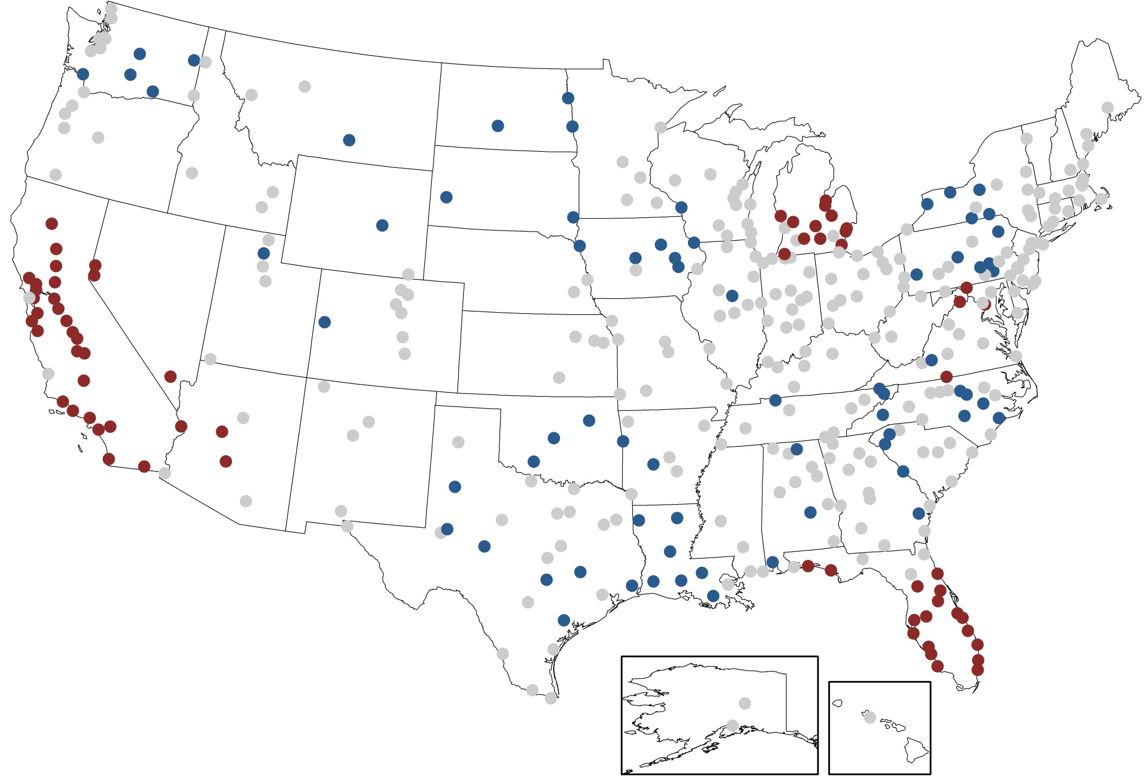
The Geography of the Housing Bust
Change in Home Prices, March 2006 – April 2009
Decline more than U.S.
Decline less than U.S.
Increase
Source: CoreLogic Home Price Index (including distressed sales).
7

Slide 9
Regional Home Price Trends
CoreLogic Single-Family Home Price Index, Seasonally Adjusted
132
Index (U.S. Peak of March 2006 = 100)
+22%
116
Buffalo
+13%
Upstate NY
Percent Change
Dec11-Jun17
100
+44%
84
United States
68
Shading indicates NBER recession
Dec11
52
2006
2007
2008
2009
2010
2011
2012
2013
2014
2015
2016
2017
Source: CoreLogic Home Price Index (including distressed sales); Aggregation and seasonal adjustment by FRBNY staff.
8

Slide 10
Regional Household Debt
Total Household Debt Balance Per Capita, 2017 Constant Dollars
$120
Thousands
$100
$80
California
$60
Nevada
United
States
Q1
$40
Upstate NY
Buffalo
$20
$0
Shading indicates NBER recessions
2000
2001
2002
2003
2004
2005
2006
2007
2008
2009
2010
2011
2012
2013
2014
2015
2016
2017
Source: FRBNY Consumer Credit Panel/Equifax, Bureau of Labor Statistics CPI, and Moody’s Economy.com.
9

Slide 11
The Performance of the Buffalo Economy Since the Great Recession
Jaison R. Abel, Research Officer
Buffalo Since the Great Recession: A Workshop on Economic Restructuring in the Rust Belt Cornell ILR School; Buffalo, NY; August 14, 2017
The views expressed here are those of the presenter and do not necessarily represent those of the Federal Reserve Bank of New York or the Federal Reserve System.

