Slide 1
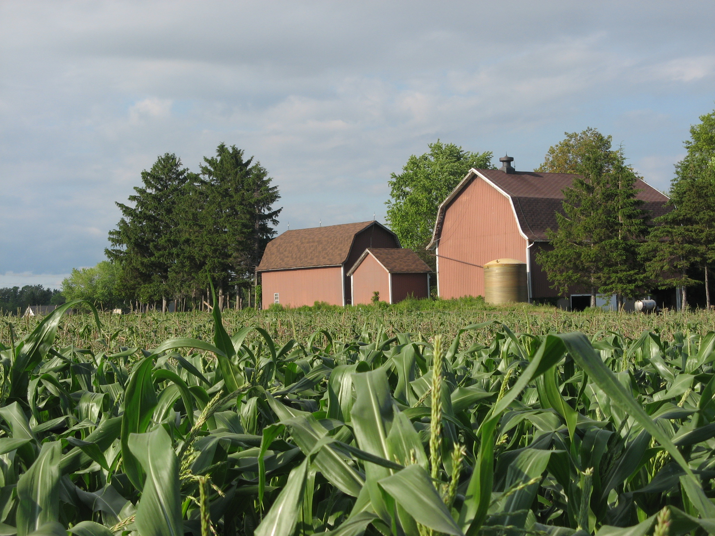
Buffalo After the Great Recession:
Agriculture

Slide 2
Buffalo: Agriculture
New York State
(2012 Census of Agriculture)
Farms
35,537 farms
Over 7 million acres of land (almost 25% land area)
Average size=202 ac
98% family owned
Operators
56,000 operators, 61,000 employees (2015-DiNapoli)
Average age of principal: 57
Race: 99% white

Slide 3
Buffalo: Agriculture
New York State
(2012 Census of Agriculture)
Market Value
Total ag products sold=$5.4 billion (23% increase) (followed a 42% increase from 2002 to 2007)
Milk sold=$2.4 billion (44% of total)
Vegetables and fruits sold=$672 million (12.4% of total)

Slide 4
Buffalo: Agriculture
Erie County
(2012 Census of Agriculture)
Farms
1,044 farms
142,679 acres of land (approx. 21% land area)
Average size=137 acres
84% have market sales under $100,000; 5% have market sales over $500,000
Operators
1044 operators
Average age of principal: 57.5
Race: 99% white

Slide 5
Buffalo: Agriculture
Erie County
(2012 Census of Agriculture)
Market Value
Total ag products sold=$133.5 million (14% increase) (followed a 27% increase from 2002 to 2007)
Milk sold=$50 million (37% of total)
Vegetables sold=$11.8 million (9% of total)
Nursery, greenhouse products sold=$28.8 million (22%)

Slide 6
Buffalo: Agriculture
Erie County
Labor
Vegetable: migrant, H2A, local
Sample wage: $12.38/hour plus housing
Dairy: migrant, local
Sample wage:
milking=$10-13/hour plus housing
General=$12-18/hour
Skilled=$18-22
Managerial=$1000-1500/week

Slide 7
Buffalo: Agriculture
Western New York
Wyoming County
top dairy producing county in the state and in top 50 dairy counties nationally
#1 in state for total ag sales
Genesee County
#4 in state for total ag sales
Chautauqua County
top grape producing county in the state
Niagara County
fruits, vegetables, dairy

Slide 8
Buffalo: Agriculture
City of Buffalo
Urban Ag History in Buffalo
MAP, Wilson Street Farm, Farmer Pirates
Green Code Market Gardens
distinguished by sale vs a community garden
allowed in specified zones
1 permit to date; previously licensed as stationary peddler if sold at a farm stand

Slide 9
Buffalo: Agriculture
Agriculture Trends
General
Loss of export markets, loss of off farm jobs (income & benefits)
Increasing farm size, loss of farmland, labor
Aging farm owners – need for transition assistance
Erie County/City of Buffalo
Urban edge: direct market farms – CSAs, farmers markets, restaurants
Examples: Native Offerings, Promised Land CSA, Plato Dale Farm, Root Down Farm, Providence Creek Farm, Groundwork Market Garden

Slide 10
Buffalo: Agriculture
NYS Laws and Policies
Constitution
Policy to encourage the development and improvement of agricultural lands for the production of food and agricultural products (1970)
Agriculture and Markets Law
Ag Districts Law to implement ag districts and ‘right to farm’ protections (1971)
Ag Protection Act to enhance economic viability of agriculture (1992)
Governor’s Initiatives
Yogurt Summit (2012)
On Farm Brewery Law (2013)
Industrial Hemp (2017)

Slide 11
Buffalo: Agriculture
Erie County and Buffalo Laws and Policies
Erie County Ag and Farmland Protection Plan
improve farm viability by protecting farmland, assisting a next generation of farmers, and enacting policies that support those goals (2009)
Food Policy Council of Buffalo and Erie County
advise local government about food system policies (2013)
Buffalo Green Code Unified Development Ordinance
land use plan and zoning (2017)

Slide 12
Buffalo: Agriculture
Boosting the Local Ag Economy
Food Hub: Eden Valley Growers
Aggregation, distribution, marketing for multiple local farms
Buffalo Farm to School: Buffalo Public School District
Connects schools & farms to improve student nutrition and support local farmers and food producers
Double Up Food Bucks: Field and Fork Network
Spend $10 of SNAP dollars at participating farmers markets and receive additional $10 to purchase local fruits and vegetables

Slide 13
Buffalo: Agriculture

