Slide 1
Buffalo’s Economic Development Compared: Buffalo as Part of the Rust Belt
Evren Dincer
Department of Sociology, Uludag University

Slide 2
Rust belt
Played a major role in 2016 presidential elections, PA, OH, MI, WI, IN, IO, MO, KY have all voted for Trump; MN, NY, and Il were the only ones voted for Clinton in the wider Rust Belt region. Results in WI, MI and PA were very close.
Core Rust Belt regions continue to suffer from manufacturing decline
Economic revitalization is promoted by all states and cities across Rust Belt
Providing incentives in various forms is key economic development policy
Increasing spatial and economic polarization across the board
“Uncoupling of the economic city” (Mallach 2015) is one of many concepts describing the deepening divide
Buffalo & WNY share many of the main characteristics with other Rust Belt cities and regions

Slide 3
Population Dynamics
Sustained population loss between1950-2000
At least 25% population loss since decline started
Detroit and Cleveland continue to lose population on a faster pace
Pittsburgh is stable, Buffalo & St. Louis are closer to Pittsburgh than Detroit & Cleveland

Slide 4
Population Dynamics

Slide 5
Population Dynamics

Slide 6
City vs Suburb
Central city areas see some increase in employment opportunities (Buffalo, Pittsburgh and St. Louis) and relatively less shrinkage than outer circles of the city (Detroit and Cleveland) however studies show these jobs are held primarily by commuters. A trend started in the 1980s and hasn’t changed since.
The chart shows percentage of city jobs held by city residents over time.
The number of commuters holding jobs in the cities has grown by an average of greater than 10% since 2002. (Mallach 2015)
 | 1960 | 1980 | 2011
Cleveland | 62.4 | 40.5 | 24.2
Detroit | 65.8 | 51.2 | 28
Pittsburgh | 64.1 | 40.8 | 25.1
St. Louis | 58.7 | 37.1 | 24.7

Slide 7
City vs Suburb cont’d
As cities lost population the ratio of city residents working in the city shrank significantly in the Rust Belt cities. The ratio of suburban population holding city jobs increased in a steady fashion.
The chart shows percentage of city residents working in the city over time.
Reverse commuters (city residents working in suburbs) mostly work in low-skill low wage jobs.
 | 1960 | 1980 | 2011
Cleveland | 92.3 | 63.1 | 46.9
Detroit | 81.8 | 57.1 | 38
Pittsburgh | 88.1 | 73.6 | 56.6
St. Louis | 91.2 | 67 | 44.1

Slide 8
City vs Suburb cont’d
The number of total jobs in the city decreased in Cleveland, Buffalo and Detroit: remained stable in St. Louis and slightly increased in Pittsburgh
However, the ratio of commuters holding city jobs increased in all five cities.

Slide 9
City centers vs outer Circles: 2002-2011
Cleveland, Detroit, and St. Louis
 | Citywide Job Change: 2002-2011 | Central Core % of City Land Area | Central Core Job Change: 2002-2011 | Balance of city job change
Cleveland | -6,106 | 5 | 11288 | -17394
Detroit | -44278 | 2 | -8014 | -36264
St. Louis | 1757 | 5 | 13326 | -11569

Slide 10
Racial Segregation
African American and white income gap widened, especially between 2000 and 2011; wiped off the relative advances occurred in the previous decade.
Shift away from manufacturing towards new economy built around healthcare and higher education, sectors that require higher education levels, hurt minorities with disproportionate access to education.
Black migration to suburbs

Slide 11
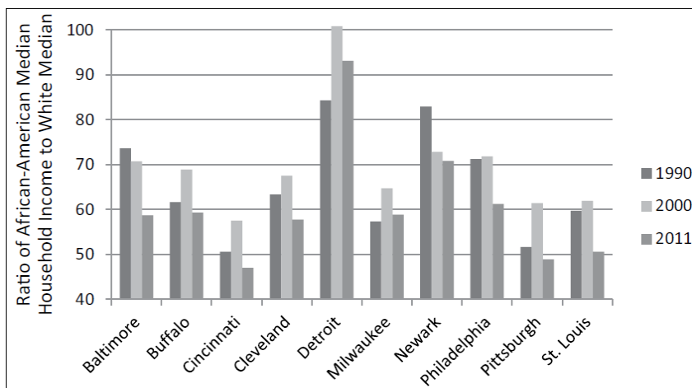
widening
Income gap
Change in the white/African-American income gap 1990–2000 and 2000–2011
Source: Mallach 2015

Slide 12
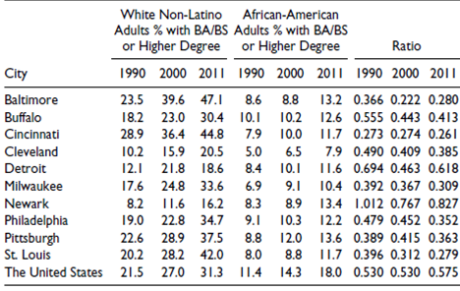
Deepening
EDUCATIONAL gap
Change in Educational Attainment for White and African-American Adults
Source: Mallach, 2015

Slide 13
Economic development
Pittsburgh
St. Louis
Downtown revitalization
Over $4.3 billion in subsidies in PA were allocated in over ten thousand awards since 1976 but mostly since 2009
Healthcare and higher education, PITT, & CMU have more than $11 billion research budget
Retained finance & insurance sectors; 27% of downtown jobs are in finance sector
Pittsburgh Downtown Partnership, Urban Redevelopment Authority (over $334 million in investment in 2014-2016), The Center for Innovation & Entrepreneurship
Downtown revitalization: over 51% of the jobs are located in St. Louis central corridor which constitutes about 5% of city’s land area (2011)
Downtown population rose from 3539 to 8155 between 2000 and 2010, 130% increase
University and healthcare employment replacing lost jobs
Over $5.5 billion in subsidies in MO were allocated in 3942 awards since 1990, but mostly since 2006
Unemployment 3.8 in MO, 4% in St. Louis metro area
North (predominantly black) South (predominantly white) divide worsened in the last two decades (Tighe and Ganning)

Slide 14
Economic development
Cleveland
Detroit
Downtown revitalization limited
Over $4.1 billion in subsidies in MI were allocated in over seventeen thousand awards since 1983 but mostly since 2011
$8 billion between 2011 and 2015 invested in the city (CED)
The Health-Tech Corridor Attraction Fund, Job Creation Incentive Program, Municipal Small Business Program, Brownfield Redevelopment, JOBS Ohio and Revitalization Grant (Department of Economic Development)
Unemployment rate 5% in OH, and 6.4% for Cleveland Metro
Move towards service economy, shrinking manufacturing employment
Detroit Economic Development Corporation
Downtown revitalization
Both downtown and outer circles declined, but the latter decline much faster highlighting the spatial divide
Over $14.1 billion in subsidies in MI were allocated in over seventeen thousand awards since 1975 but mostly since 2004
Unemployment rate 3.8% in MI, 3.7 in Detroit

Slide 15
ConclusionS
Economic revitalization exists but it is distributed among certain sectors and locations while excluding others
It does not yield city-wide results, instead deepening existing racial and economic divides
City vs suburb divide is also on the rise as commuters benefit more from economic revitalization than urban residents
Economic revitalization policies do not directly target educational attainment gap, though there is some interest in workforce development
Education is a major problem; STEM focused investments have not been successful yet

Slide 16
ConclusionS
“A tale of two cities,” “divergent city theory,” “uncoupling of economic city”
Public funds play a key role in promoting and sustaining development in all Rust Belt cities
Revitalization efforts focusing on select sectors give negative results
Buffalo & the metro area shares many characteristics with other major Rust Belt cities & metro areas

