Slide 1

The Canadian Auto Industry Before and After the Great Recession: A Look at Buffalo from the Other Side of the Border
By mathieu dupuis, in collaboration with brendan sweeney
Postdoctoral researcher,
Automotive policy research centre, mcmaster university,
Crimt, university of montreal

Slide 2
Context
The auto industry in Canada is a major and strategic industry. 14.8% of all Canadian exportations in 2012 (97.8% go to the US). In 2016, the sector represented 10.88% of the manufacturing GDP.
Historically, the industry has been dependent on the US Big Three for investment. E.g. First plant in Windsor (1904) was producing the Ford Model C.
Policy-makers aimed at fostering investment while strengthening the suppliers base.
The Autopact period (1965-2001) has been marked by growth. The Free trade and Post-crisis era (2001-…) has been characterized by a slow shrinking of the industry.

Slide 3
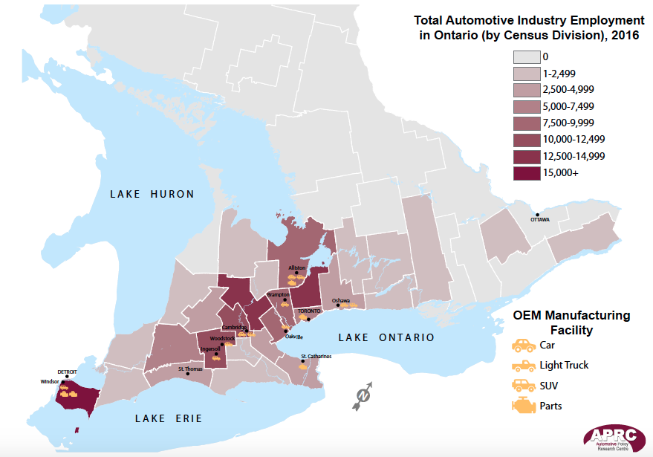
Source: Sweeney, 2016

Slide 4
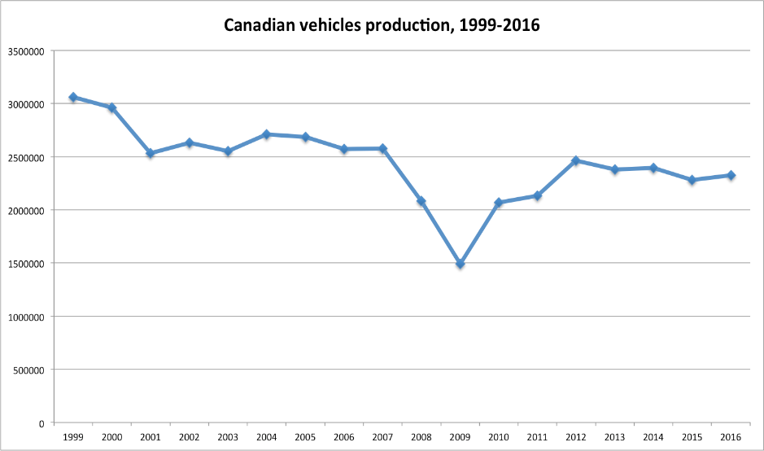
Source: StatCan

Slide 5
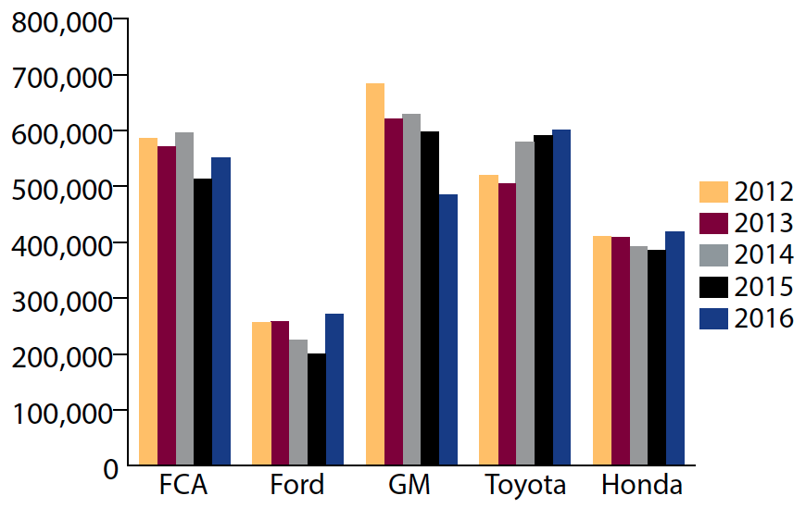
Production by OEM
Source: Sweeney, 2016

Slide 6
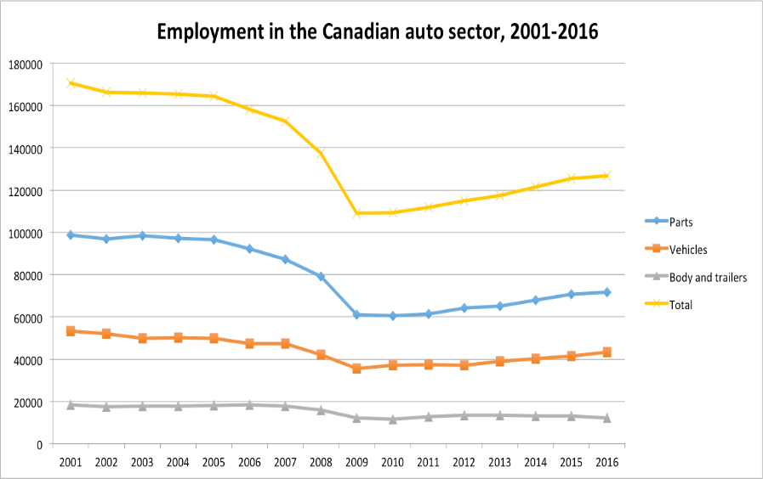
Source: StatCan, 281-0023

Slide 7
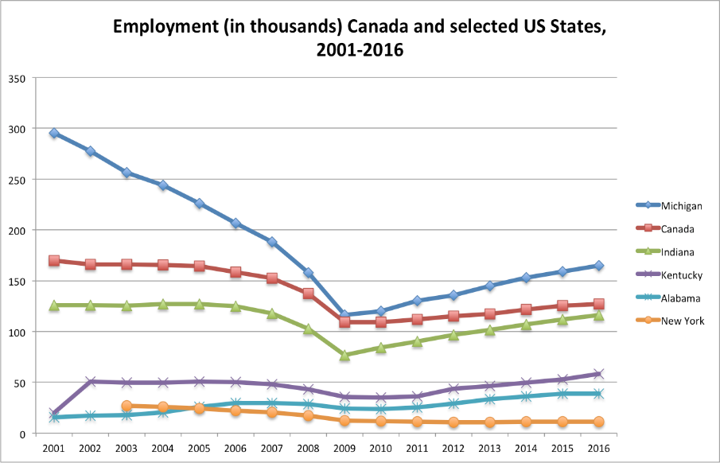
Source: Stat Can, BLS

Slide 8
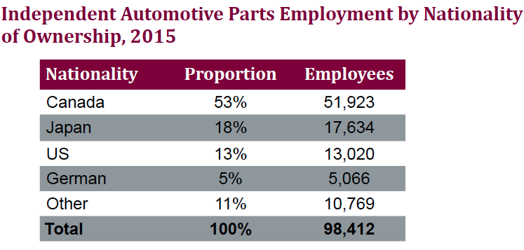
The IAP sector in a glance
Source: Sweeney, 2016

Slide 9
What about the Japanese?
Three auto plants in Canada, and one truck plant. Toyoto (2), Honda, and Hino.
2016: 44% of total production in Canada. Surpassed the 1 million units produced.
13 308 direct employees in manufacturing, 35% of all jobs in the industry vs 17% in 2001.
Almost 20% of the parts industry is Japanese-owned.
No plants are unionized.

Slide 10
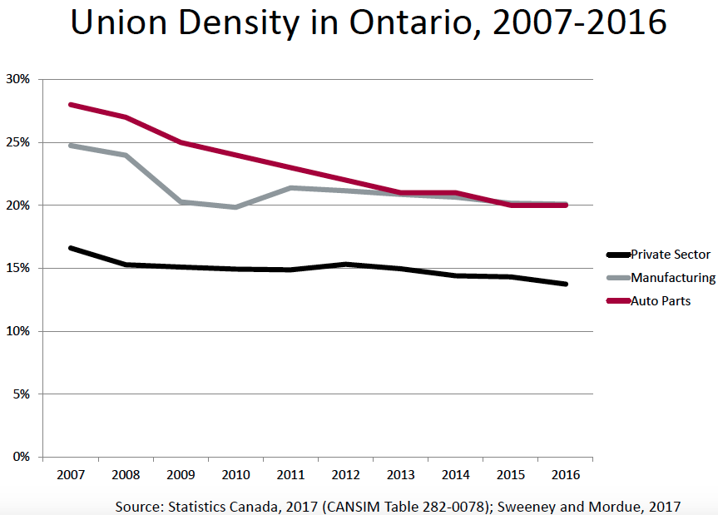

Slide 11
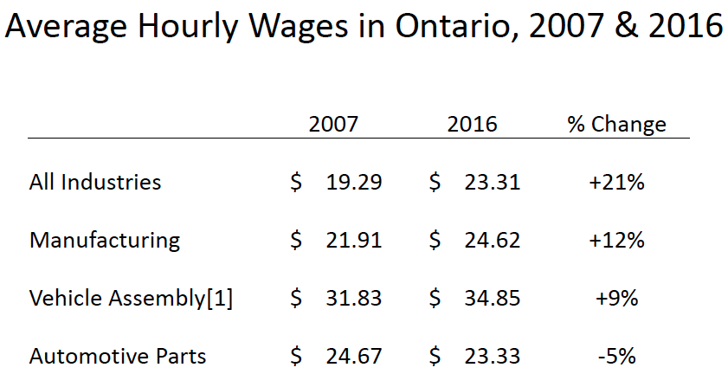
Source: Sweeney, 2016

Slide 12
Recent trends in collective bargaining
The CAW identity has long been associated with militancy.
As some scholars have noted at the end of the 1990s, this militancy has somehow faded.
The great recession: a turning point in terms of labor relations. (E.g. Grow-in, shedding of several bonuses, contributions on pension plans and insurances). Factors: “retreat” of the state, aging workforce, old plants, the US concessions.
The 2016 round: “Invest in Canada” has become the new mantra for Unifor. Concessions in the pension plan for new hires (DB to DC).

Slide 13
Success?...
GM: Investments in Oshawa, St-Catharines, and Woodstock. Was in line for Government aid, refused in February. ($554-million).
FCA: Investments in Brampton, still in line for Government aid. ($325-million, Government aid not yet disclosed).
Ford: Investments in Essex engine (Windsor) and Oakville (Toronto) for a new research and engineering center. Both projects are co-financed by government. ($1.2-billion, $204-million from Ontario and Federal).

Slide 14
… Compared to other jurisdictions?
In 2014, before the auto negotiations, Mexico and the US were attracting the lion’s share of investments.
According to the Centre for Automotive Research:
$18,25-billion in new investments,
US: $10,5-billion.
Mexico: $7-billion.
Canada: $750-million.

Slide 15
Prospects for the Industry
There is sign of a slow decline of the Canadian auto industry: no new plant, low investments, and the industry has not yet recovered from the Great recession.
What will happen to the industry in the Trump’s era?
Is the renegotiation of the NAFTA will impact the industry?
Canada’s Share of North American sales (9%) vs Auto jobs (6%). Return to the “Fair Share” argument?
The industry is highly integrated and several states in the US have interest to strike a good deal.
Challenges for business, unions, and certainly policy-makers in Canada.
Notes:
As the Financial Post stated, the industry is in existential crisis.

