Slide 1
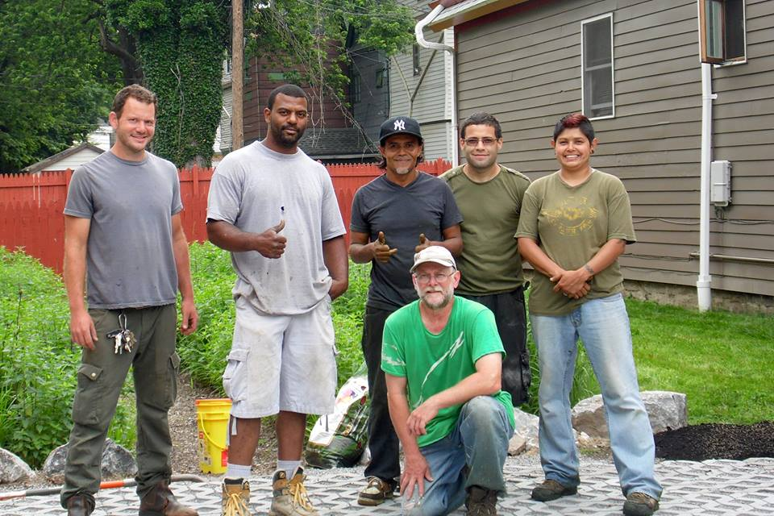
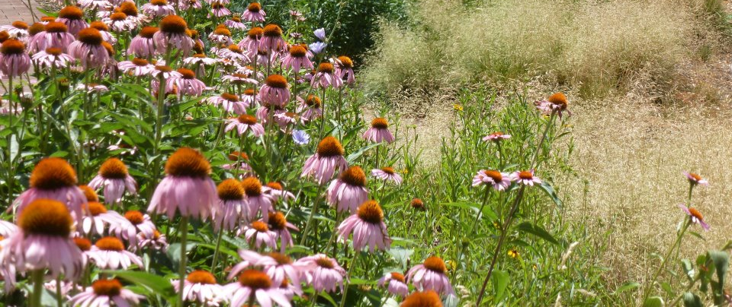
People United for Sustainable Housing A Just Transition Story
Buffalo, New York
Notes:
Jen

Slide 2
A STRATEGY FRAMEWORK FOR JUST TRANSITION Eco-System approach to build a regenerative and just world.
Extractive Economy
Regenerative Economy
B
U
I
L
A
D
D
T
E
B
H
H
E
R
L
D
V
T
R
L
D
V
I
P
N
I
W
O
E
W
O
E
W
O
E
W
T
S
W
BUY!
Consumerism & Colonial Mindset
CHANGE THE RULES
DRAW DO WN MONEY AND PO WER
International
Caring & Sacredness
W
O
R
K
W
O
R
K
E
S
O
U
R
C
E
P
U
R
P
O
S
E
R
E
S
O
U
R
C
E
S
P
U
R
P
O
S
E
R
S
+
+
National
Extraction Dig, Burn, Dump
Enclosure of Wealth & Power
Regeneration
Ecological &Social Well-being
Exploitation
Cooperation
V
E
R
N
A
N
O
V
E
R
N
A
N
C
O
C
G
E
G
E
Local
DI
V
E
R
S
E
T
W
F
O
R
P
W
O
R
O
M
T
U
R
Deep Democracy
Militarism
S
H
N
O
&
G
E
I
T
I
T
D
A
R
S
P
E
E
R
O
N
V
F
E
V
E
W
E
I
&
S
T
O
P
R
VALUES FILTER
Shift economic control to communities Democratize wealth and the workplace Advance ecological restoration
Drive racial justice and social equity Relocalize most production and consumption Retain and restore cultures and traditions
Developed by Movement Generation with
A JUST TRANSITION
MUST:
16
17

Slide 3
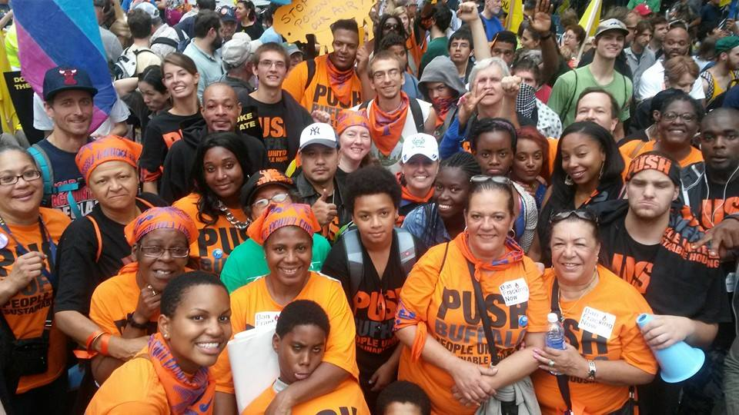
People First – “We Know what we want, where we live”

Slide 4
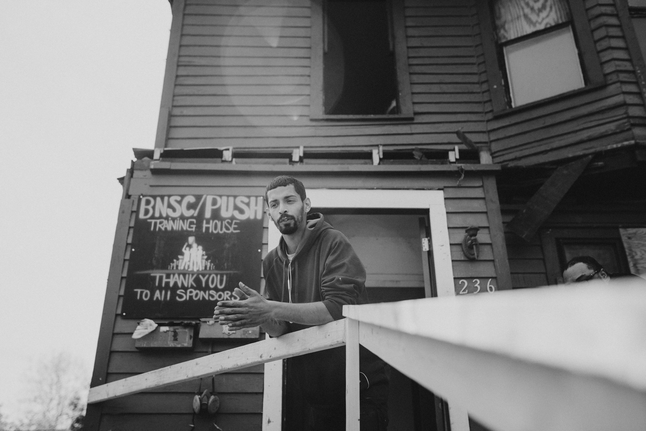
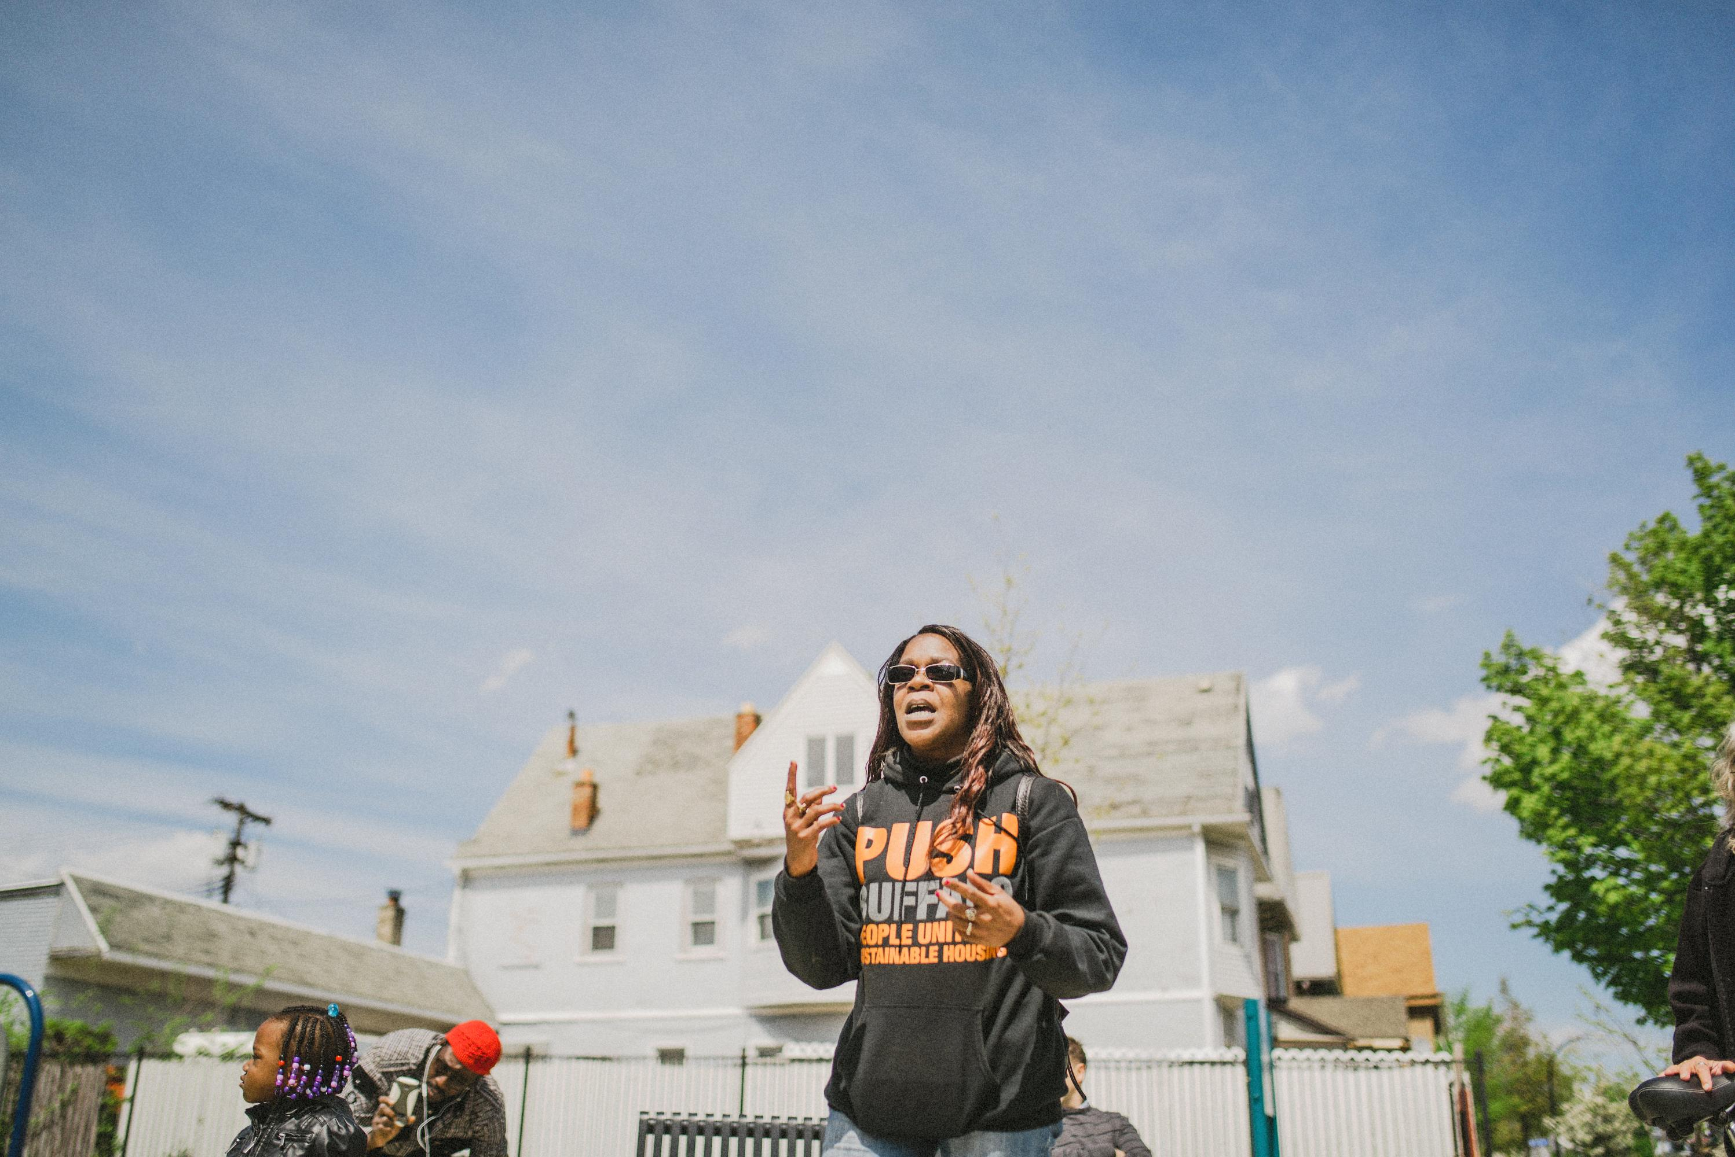
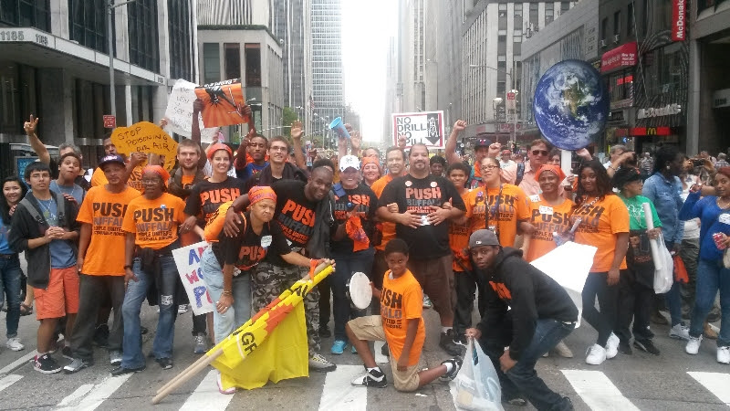
Resident Leaders Paving the Way Forward

Slide 5
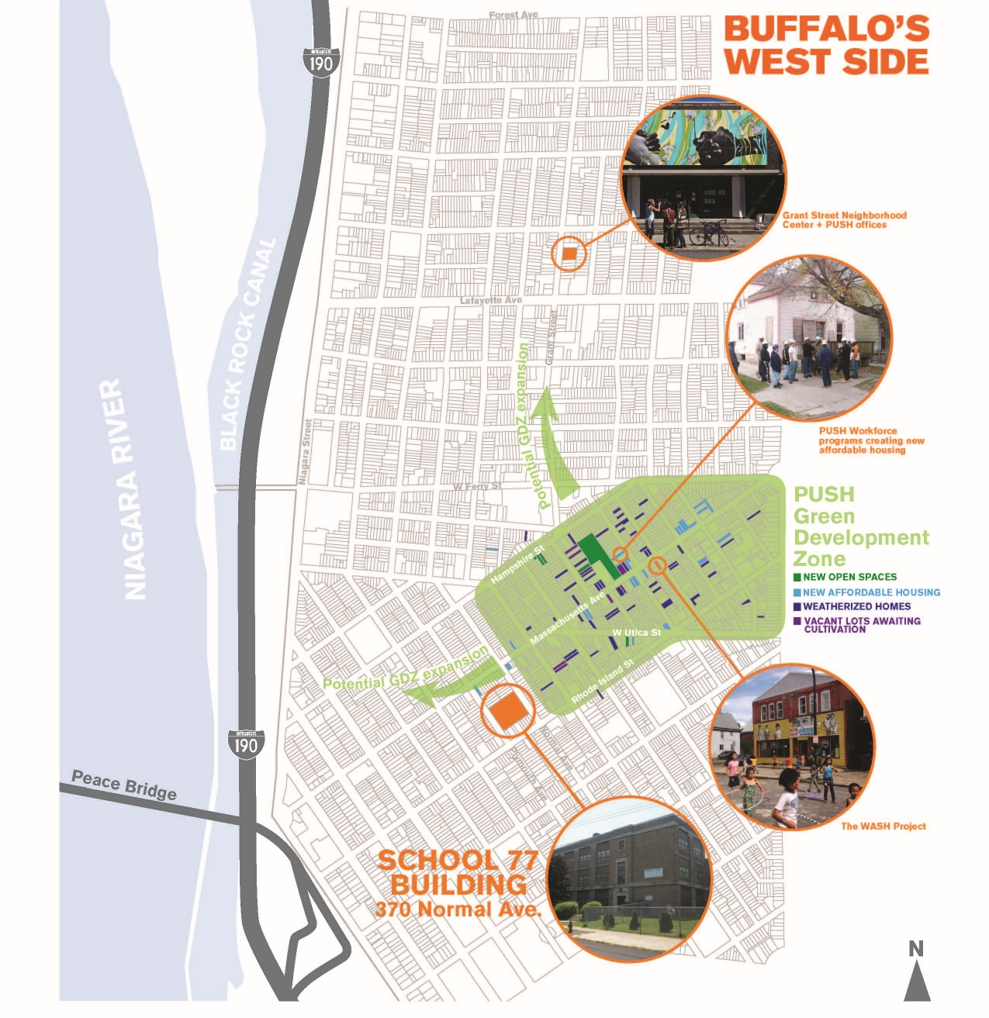
Green Development Zone

Slide 6
Notes:
In one charrette, Hester Street helped design a few exercises to engage participants. In one, people thought threw how the building would be used by role playing different users of the building. In another, they used game pieces on a site plan to indicate needed parking, play areas, and landscaping.

Slide 7
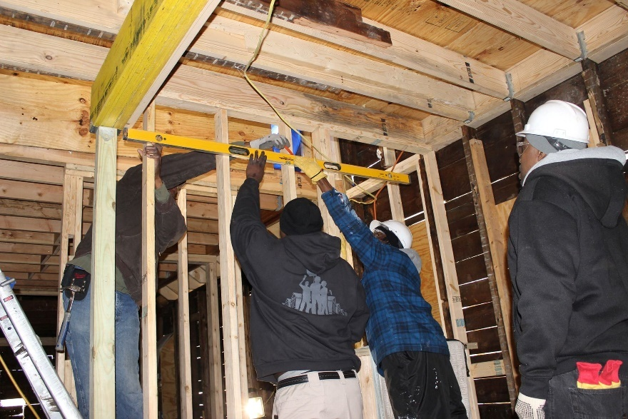
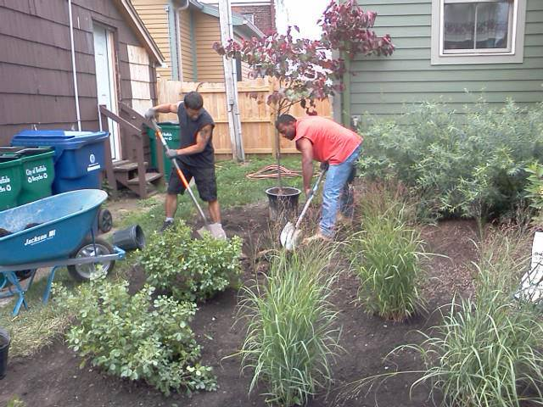
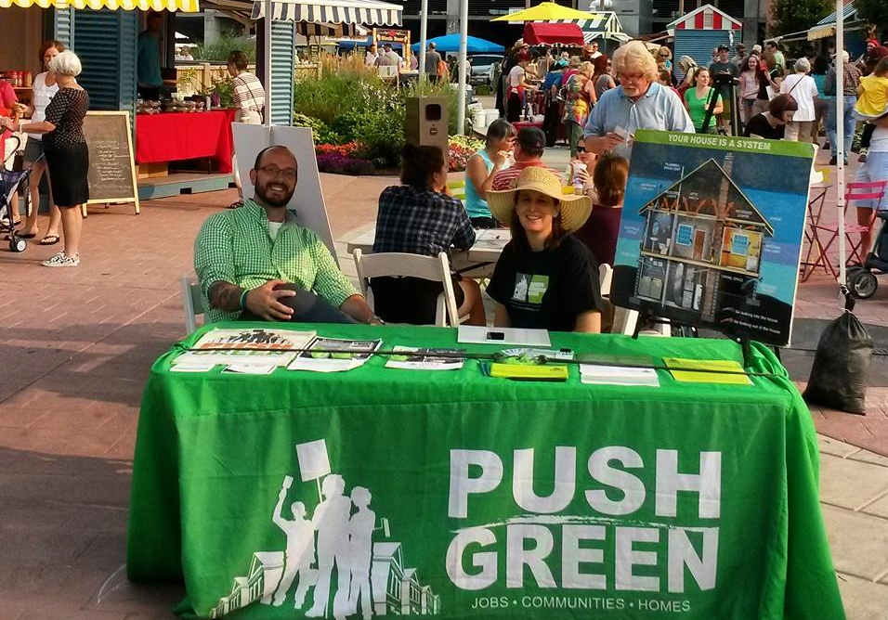
Creating Green Jobs- Connecting People to Energy & Power
Notes:
Clarke

Slide 8
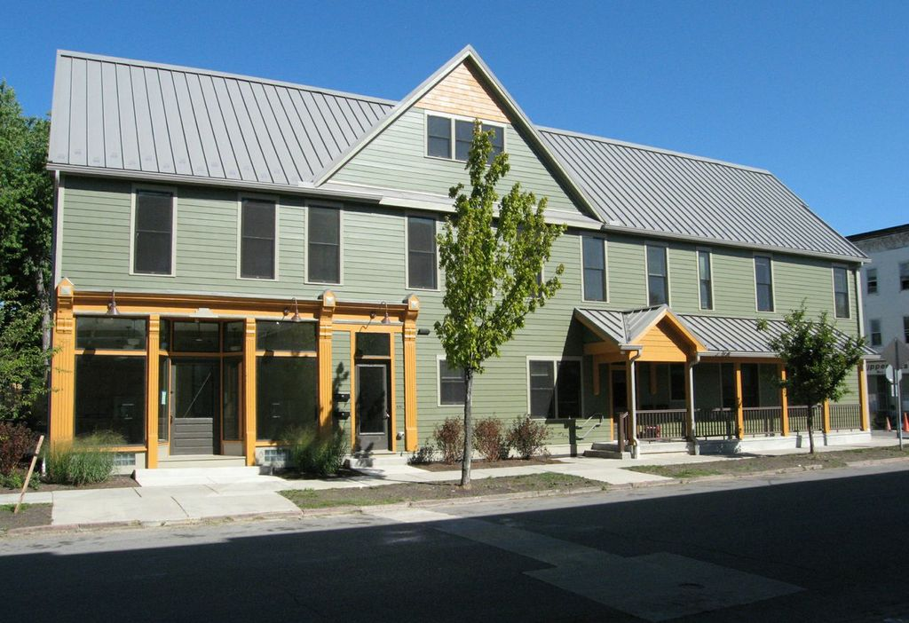
Restoring Vacant Properties to green affordable homes

Slide 9
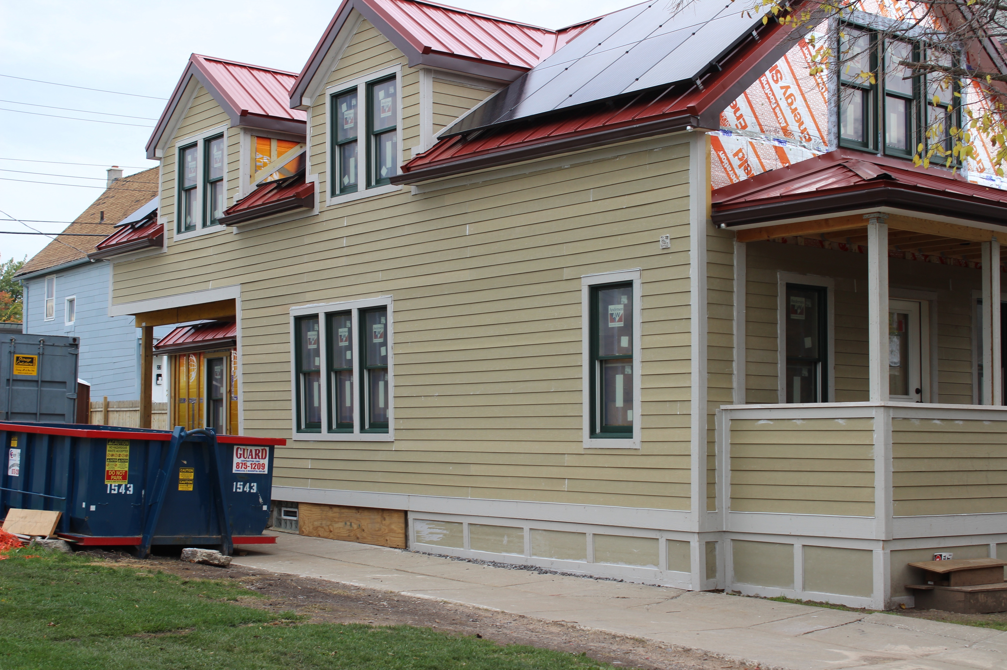
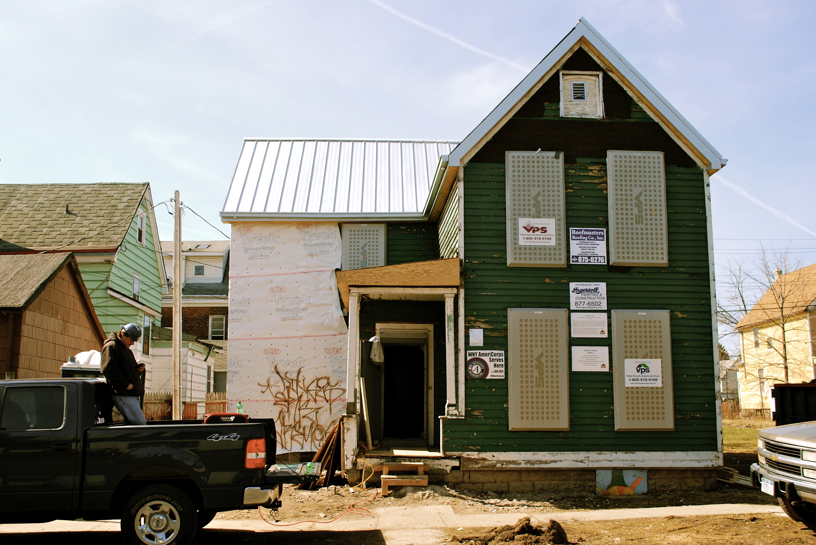
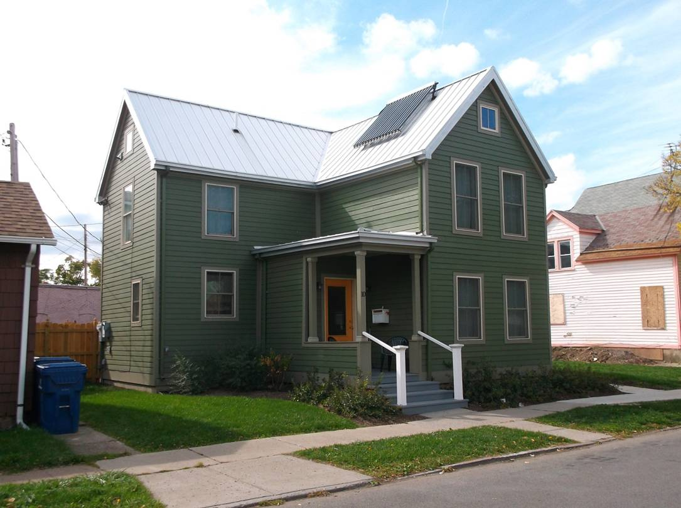

Slide 10
Mobilizing for Energy Affordability and Energy Democracy

Slide 11
PUSH Green Connecting People to Energy and Power
Energy Efficiency Arm of PUSH Buffalo contracted by NYSERDA to implement State- Wide Energy Efficiency and Solar Initiatives.
Advocacy
Community Benefit Agreements with local contractors
High road job creation
Alliance to address policy change surrounding energy efficiency and renewable energy (solar).

Slide 12
Green Infrastructure to Address CSOs
To address Combined Sewer Overflow and promote ecologically sound practices, PUSH Blue carries out design, installation, and maintenance of:
Rain Gardens
Green Roofs
Vegetated Swales
Stormwater Planters
Permeable Pavement
Pollinator Gardens
Community Gardens
Riparian Buffers
Vegetated Filter Strips
Soil Amendment
Native Plant Landscaping
Water Storage Cisterns

Slide 13
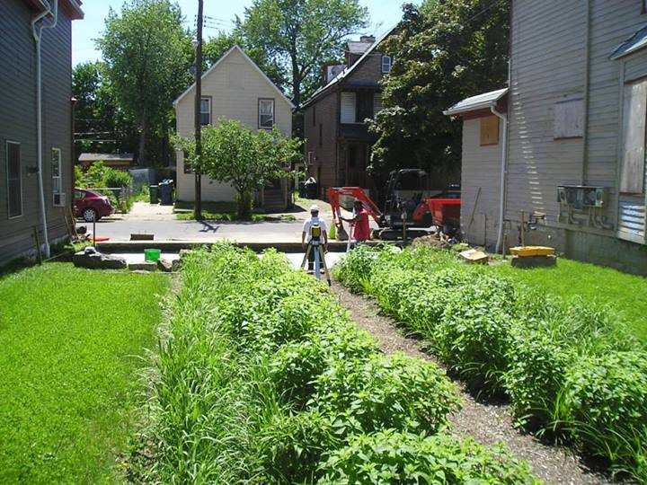
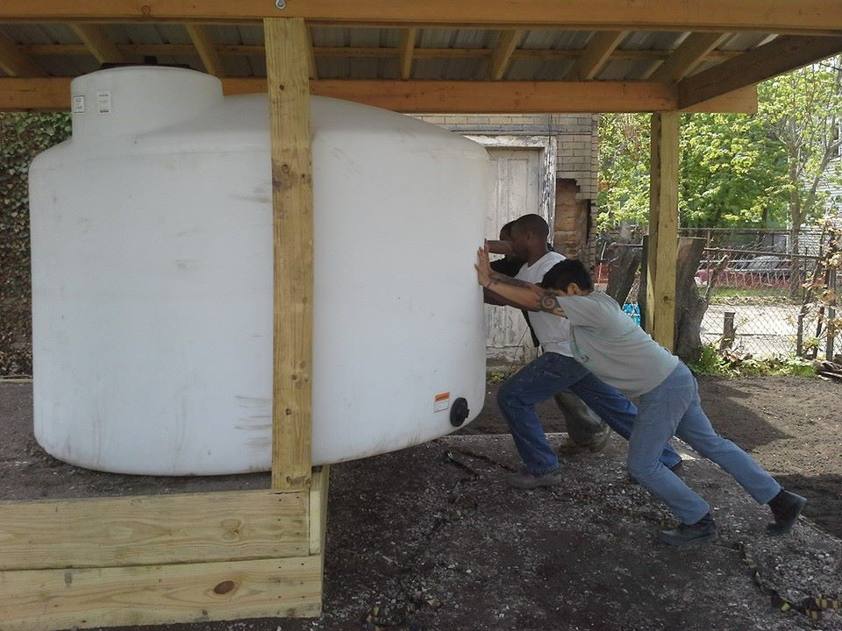
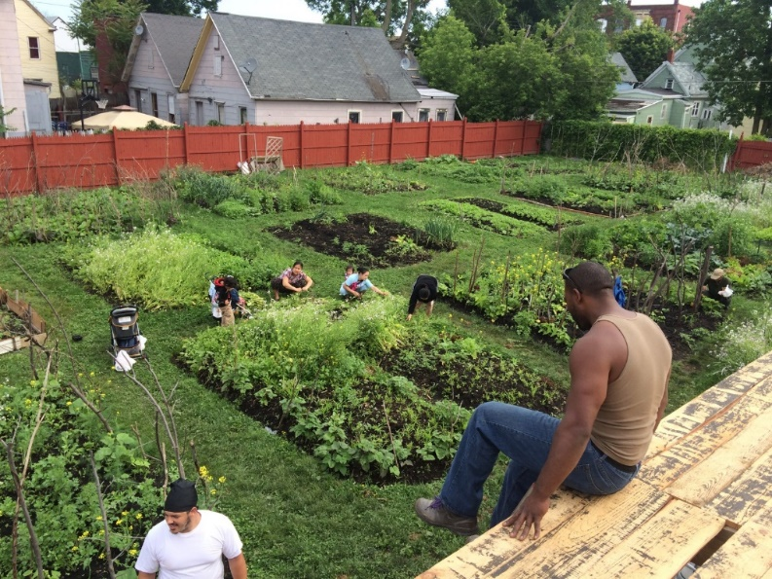
GI Installations
Left: Permeable parking pad
Right: Raingarden
Left: Cistern
Right: 14th Street Community Garden

Slide 14
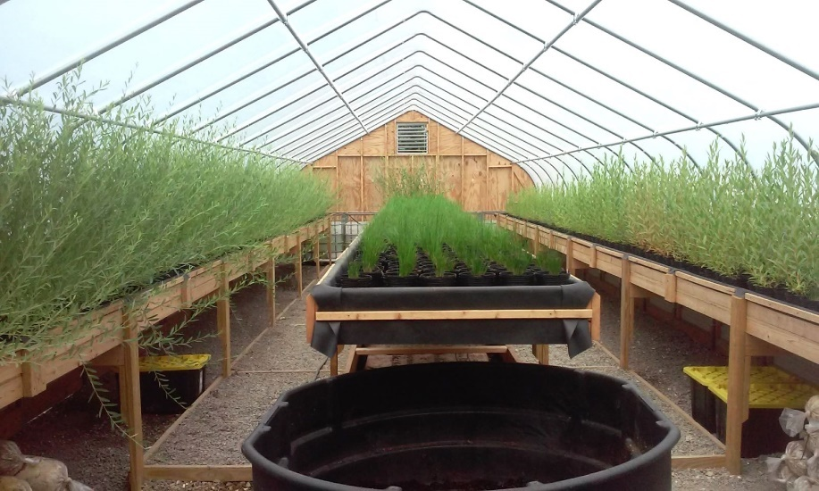
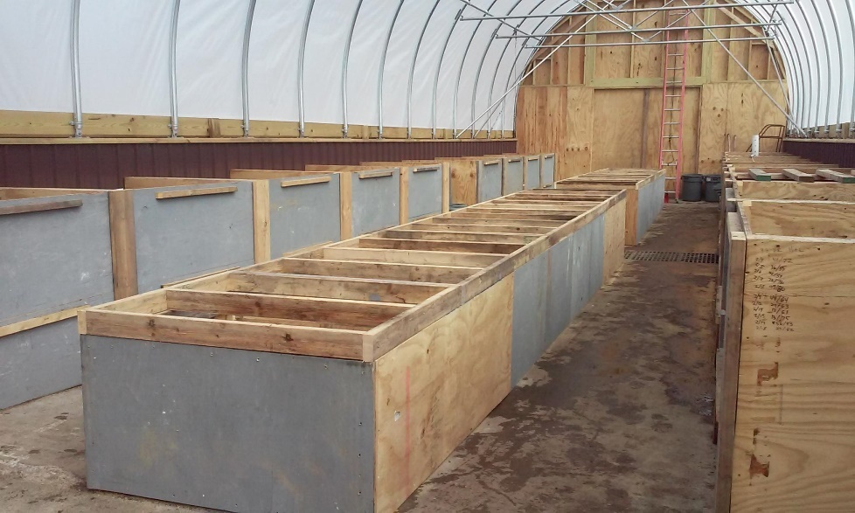
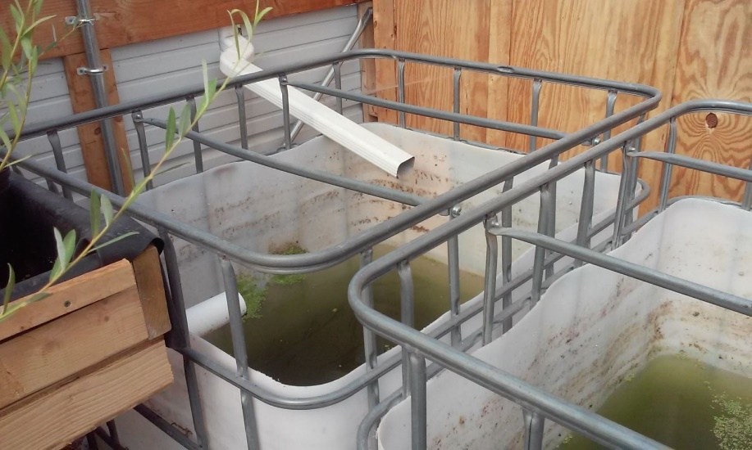
Composting and Native Plants

Slide 15
Green Infrastructure Team Members

Slide 16
Systems Impact
$19 million invested in green affordable housing, green infrastructure and stormwater management in the Green Development Zone
More than 500 homes transformed through weatherization or green retrofit
Over 60 green jobs created and over 200 workers trained in training programs
More than $90 million new investment in weatherization across the state
Housing policy focused on rehabilitation of vacant structures and neighborhood revitalization
Approximately 200 metric tons of CO2 reduced on annual basis

Slide 17
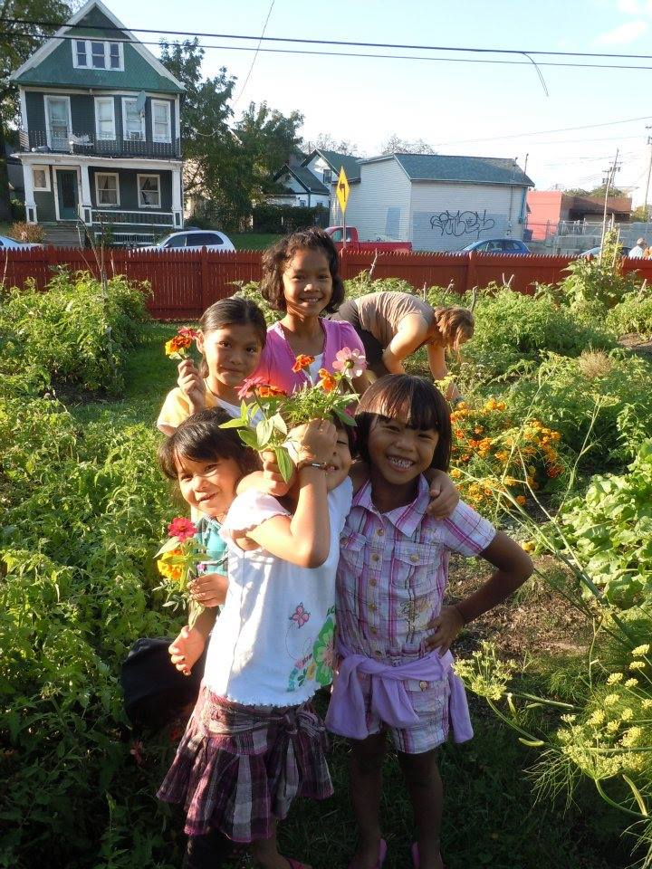
Educating Future Generations towards a Just Transition

Slide 18
Mycelium, Worms and Composting = FUN

