Slide 1
Sector Based Workforce Strategies
The Worker Institute, Cornell University ILR School
August 14, 2017

Slide 2
What is a Sector Based Workforce Strategy?
Regional, employer-driven partnerships of industry, education, and training, and other stakeholders that focus on the workforce needs of key industries.
Sector initiatives rely on workforce intermediaries to serve as conveners to engage employers and other stakeholders to:
  Develop expertise in the industry of focus
  Coordinate information and resources to develop and implement coordinated responses.
As defined by organizations such as the Corporation for a Skilled Workforce, National Governors Association Center for Best Practices, and the National Network of Sector Partners

Slide 3
Sector Strategies align with Career Pathways
High quality education, training, and other services that:
Aligns with industry needs.
Prepares an individual to be successful in a range of secondary and postsecondary options, including Registered Apprenticeships.
Includes counseling, education, and workforce preparation activities.
Organizes education, training, and other services to meet the needs of an individual.
Enables an individual to attain a secondary school diploma or its equivalent and at least one recognized post-secondary credential.
Helps an individual enter into or advance within a specific occupation or occupational cluster.
Workforce Innovation and Opportunity Act, 2014

Slide 4

Development of Sector Workforce Strategies in Buffalo/Erie County
2011 Regional Economic Development Councils
    Eight priority Industries identified for Western Region
    WNY Job Readiness Workgroup
2012 Empire State Development/McKinsey & Company focus groups
2013 Advance Buffalo
    A workforce initiative of the Buffalo Billion Economic Development Strategy
    Led by the NYS Department of Labor - matches job seekers with businesses in the Advanced Manufacturing industry.

Slide 5

Sector Workforce Strategies in Buffalo/Erie County
WIB initiatives build upon groundwork laid by Erie County Executive Mark Poloncarz:
  2012 Workforce Summits-to identify community needs, employer needs, and available resources.
  2012-2013 Employer Forums-taking a “deep dive” to learn employer needs for specific industries.
  2014 Hospitality working group established.
  2015 First sector program launched.

Slide 6
Role of Workforce Investment Board
Convene employers
  How can the workforce system be more effective in meeting employer needs?
  Agree to work together
  Select training provider
  Develop training program to fit business needs
  Conversations about what is “really” needed
WORKFORCE SYSTEM
INDUSTRY
TRAINING PROVIDER
BUSINESS ASSOCIATION

Slide 7
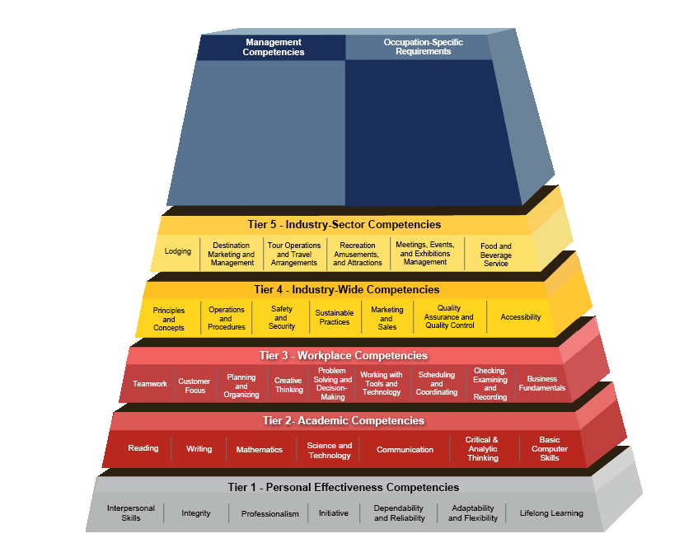
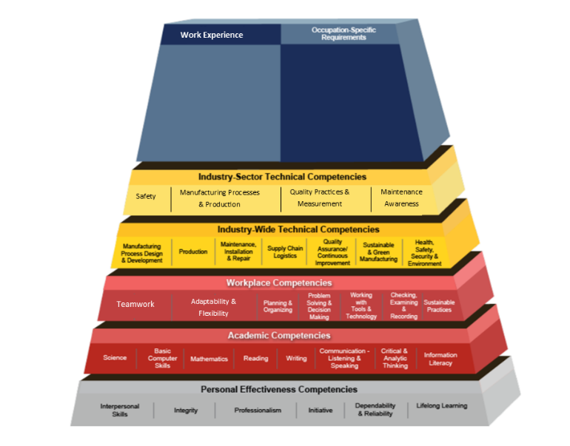
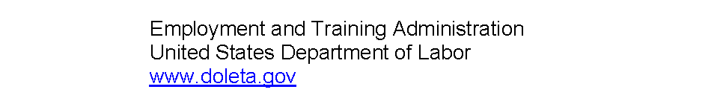
Hospitality/Tourism
Advanced Manufacturing

Slide 8
Workforce Board Activity
Align workforce strategies with REDC demand industries
Ensure policies support Sector Strategies and Career Pathways
Individual Training Account
Expanded Supportive Services
Enhanced collaboration with system partners
On The Job Training (OJT)

Slide 9















Hospitality/Tourism Workforce Strategies
Front Desk Operations
300-hour training program-developed with employer input
Led to nationally recognized credential: The American Hotel & Lodging Educational Institute (AHELI)

Slide 10
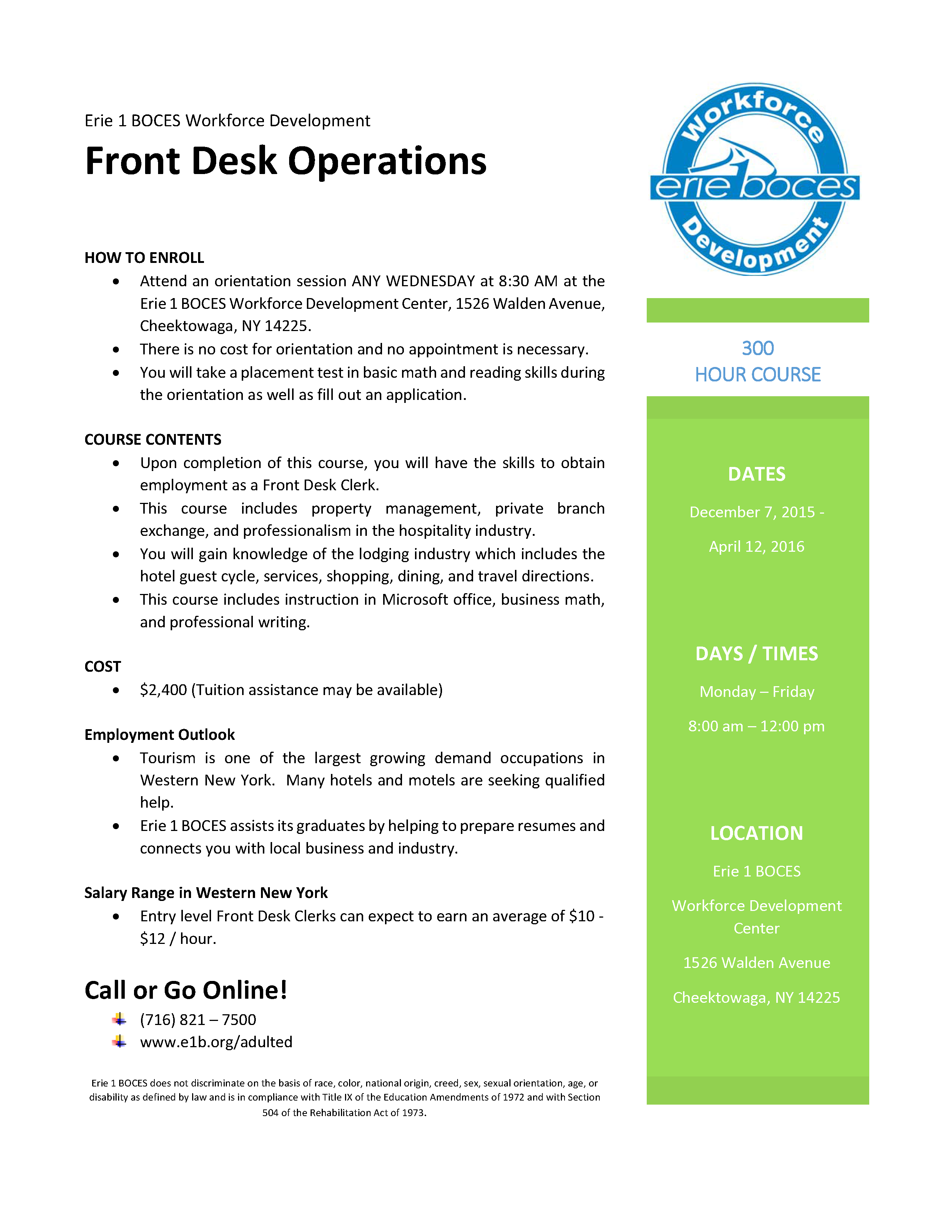

Slide 11

Hospitality/Tourism Workforce Strategies
Check-In to Success: Customer Service for Hospitality-November-December 2016
Sponsored by Delaware North Companies, Inc.
Specifically for City of Buffalo residents
45-hour course- led to nationally Recognized Credential
  The American Hotel & Lodging Educational Institute (AHELI)
  Guest Path Training

Slide 12
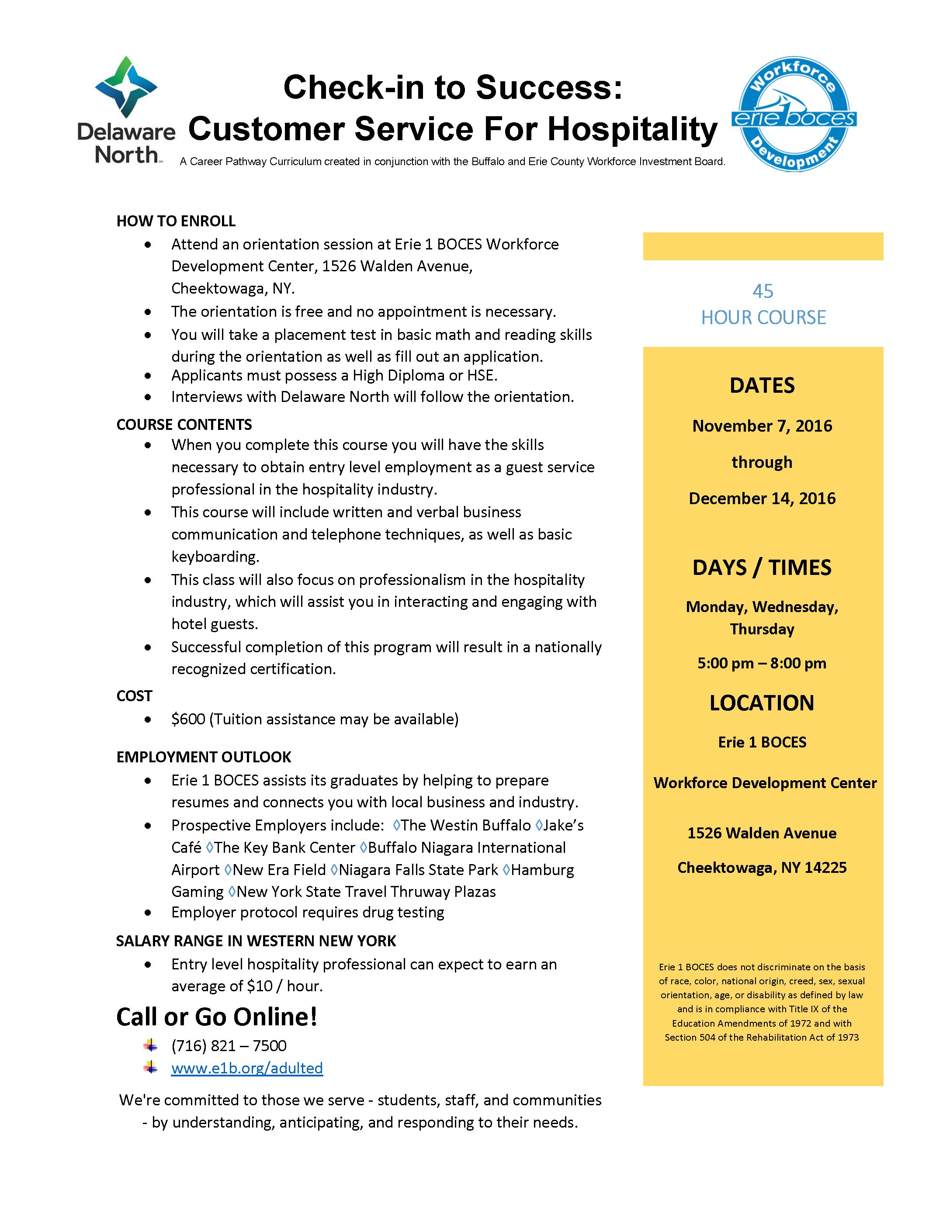


Slide 13

Advanced manufacturing workforce strategies
Course Components Included:
Safety
Manufacturing Processes & Production
Quality Practices & Measurement
Maintenance Awareness
Included “Earn While You Learn” component

Slide 14
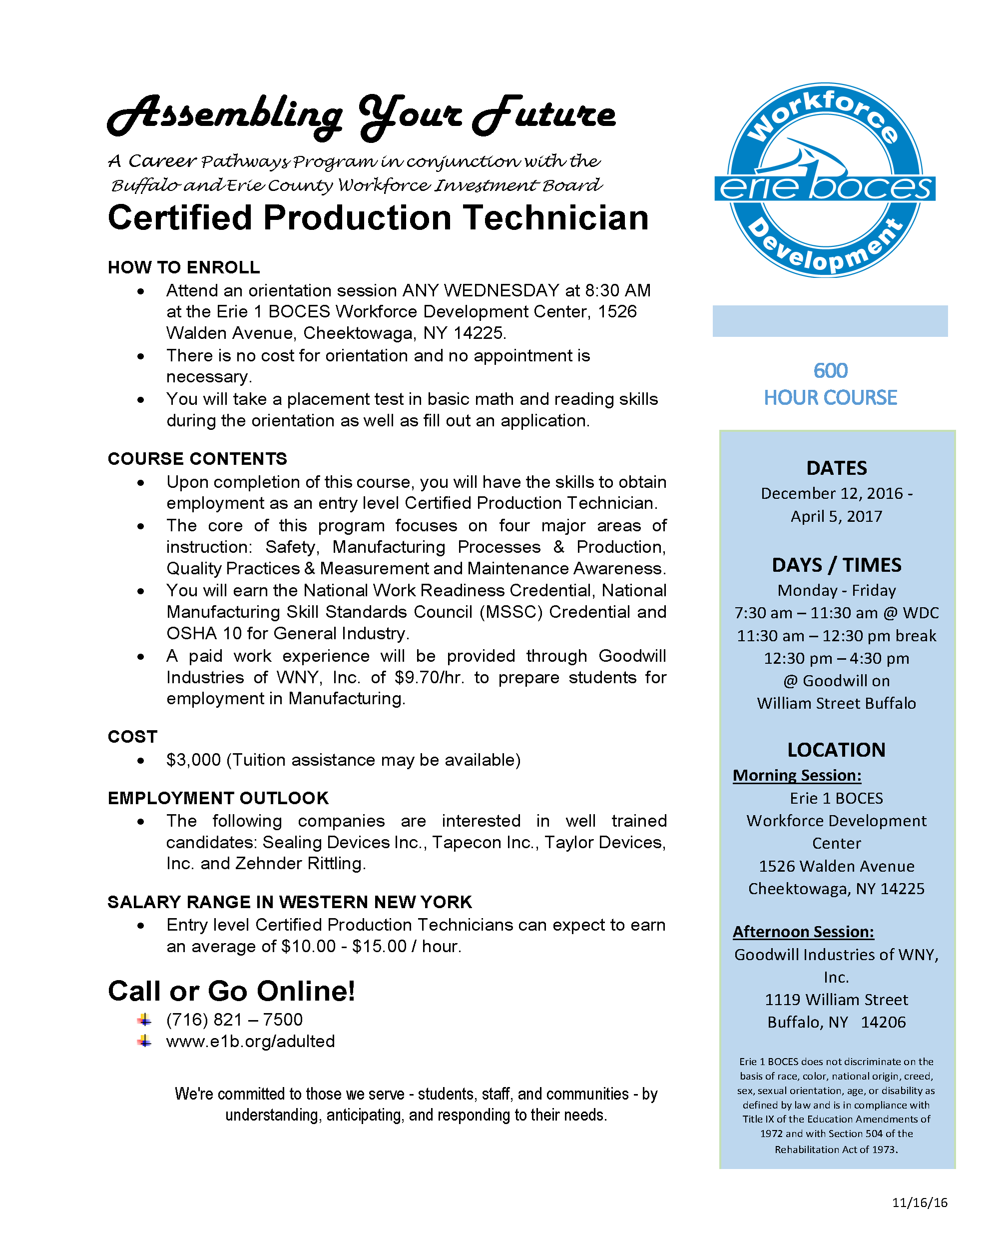

Slide 15
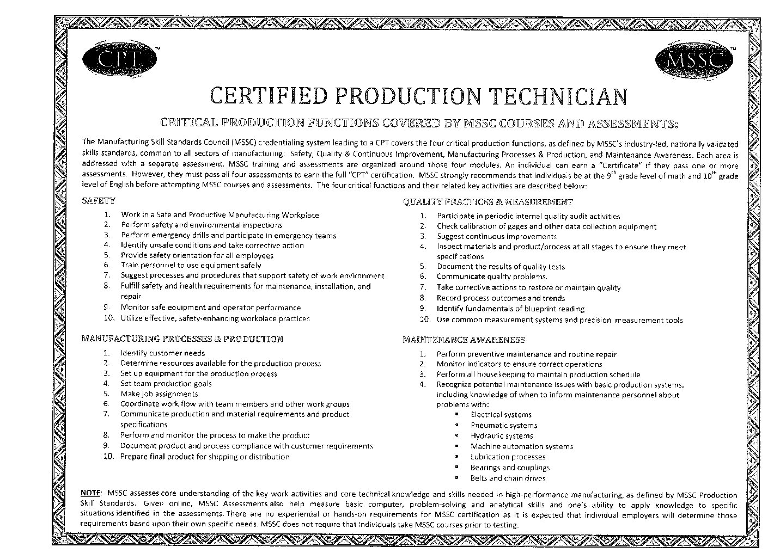

Slide 16
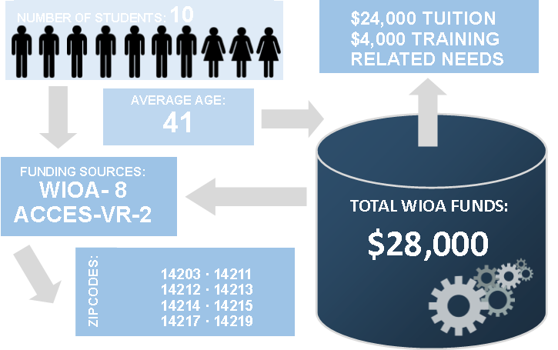
Assembling your future:
Certified Production Technician

Slide 17

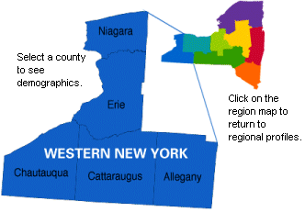
Other Workforce Strategies
Western Region Sector Partnership Program
Planning grant awarded to Buffalo & Erie County Workforce Investment Board
Work with workforce boards in Western Region
Identify workforce strategies within targeted industry sectors
Develop career pathway template

Slide 18











What’s Next?
Expansion of existing pilot programs
  Assembling Your Future - Winter 2018
Development of pilot program for Customer Service industry

Slide 19
THANK YOU!
Heather Gresham, Executive Director
Buffalo and Erie County Workforce Investment Board
Gresham@becwib.org
www.becwib.org
716-504-1480

